Slide 1
Tree Selection
Paul Hetzler, ISA Certified Arborist
paul.j.hetzler@gmail.com
(613) 255-4966

Slide 2
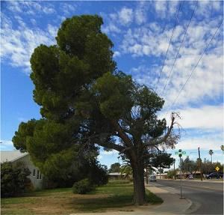
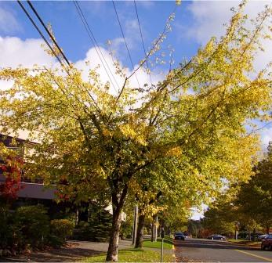
Right Tree, Right Location

Slide 3
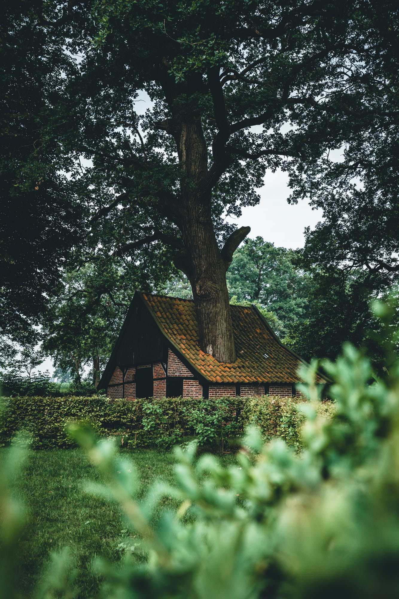
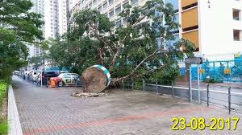

Slide 4
Right Tree for the Right Location
Why is it important?
The right tree for Site X will:
Save loads of $$$$
Look better
Live longer (and prosper)
Be safer
Generate fewer complaints
Need less maintenance

Slide 5
Reasons for Selection
Potential Site Issues:
Road Salt Exposure
Space Constraints
Drought-Prone
Seasonally Wet/ Poorly Drained
Under Wires
Alkaline Soil
Compaction

Slide 6
Selective Service

Slide 8
Degrees of Selection
Species
Cultivar
Individual

Slide 9
Species:
Betula nigra (river birch)
Great deal of genetic variation within the species = inconsistent results.
Cultivar:
Betula nigra ‘Heritage’ (Heritage river birch)
Cultivated variety with superior qualities = consistent results.

Slide 10
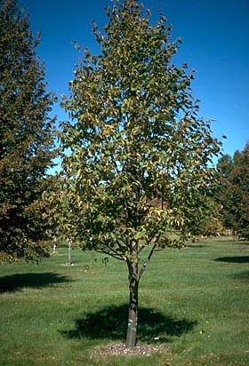
Individual: Select for Form Don’t Pay for Trouble! Good Form

Slide 11
Single Central Leader!
There’s no way to fix this:

Slide 12
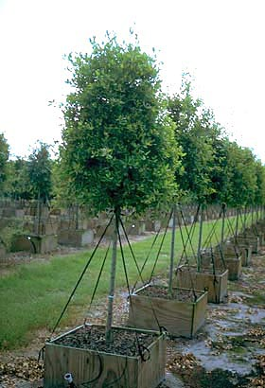
“Lollipops” Can Disguise Bad Form

Slide 13
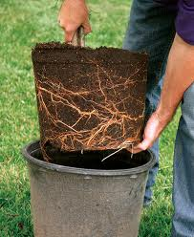
Don’t Forget the Roots! Unacceptable: OK w/ Pruning:

Slide 14
Temporary Branches are Important for Strong Trunk Development

Slide 15
Beware of Trunk Wraps

Slide 16
Always Check Under Wrap Before Accepting

Slide 17
