Slide 1
Tick-Borne Illness Awareness and Prevention
Paul Hetzler, Cornell Cooperative Extension of St. Lawrence County
Paul.j.hetzler@gmail.com

Slide 2
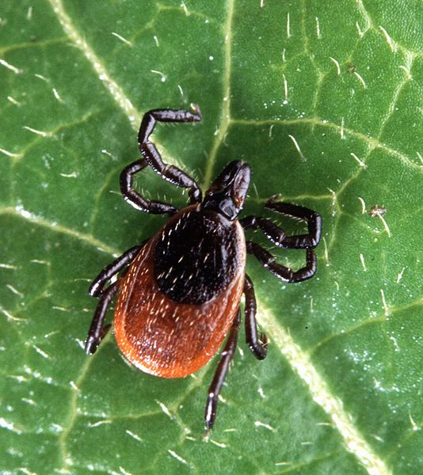
Deer Tick, a.k.a Blacklegged Tick or Ixodes scapularis

Slide 3
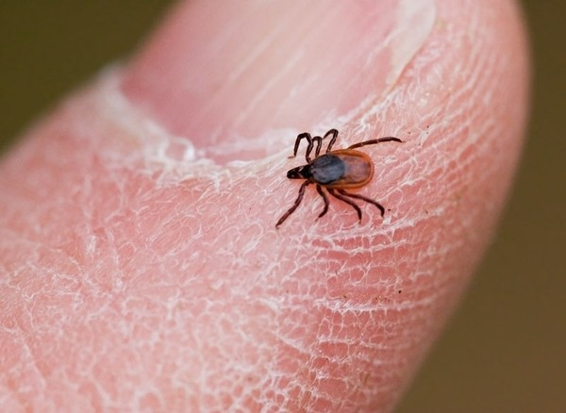
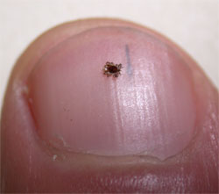
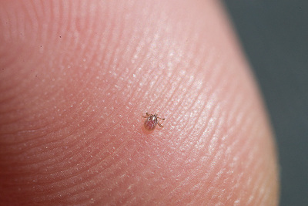
Adult vs. Nymph vs. “Larva” (1st instar nymph)

Slide 4
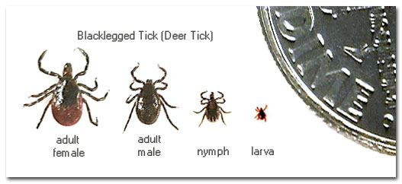

Slide 5
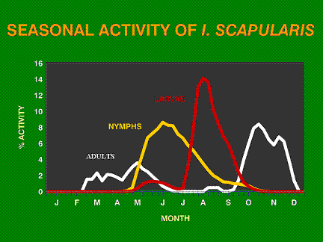
Notes:
Ticks seek hosts whenever the temps are 40’.Most tick bites occur from late May thru Aug. 90% all cases are by nymphs. Adult ticks become active in the fall. Pass ticks around.

Slide 6
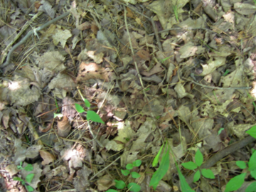
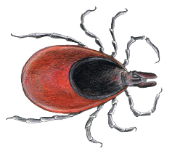
Where do ticks live?
In the leaf litter.

Slide 7
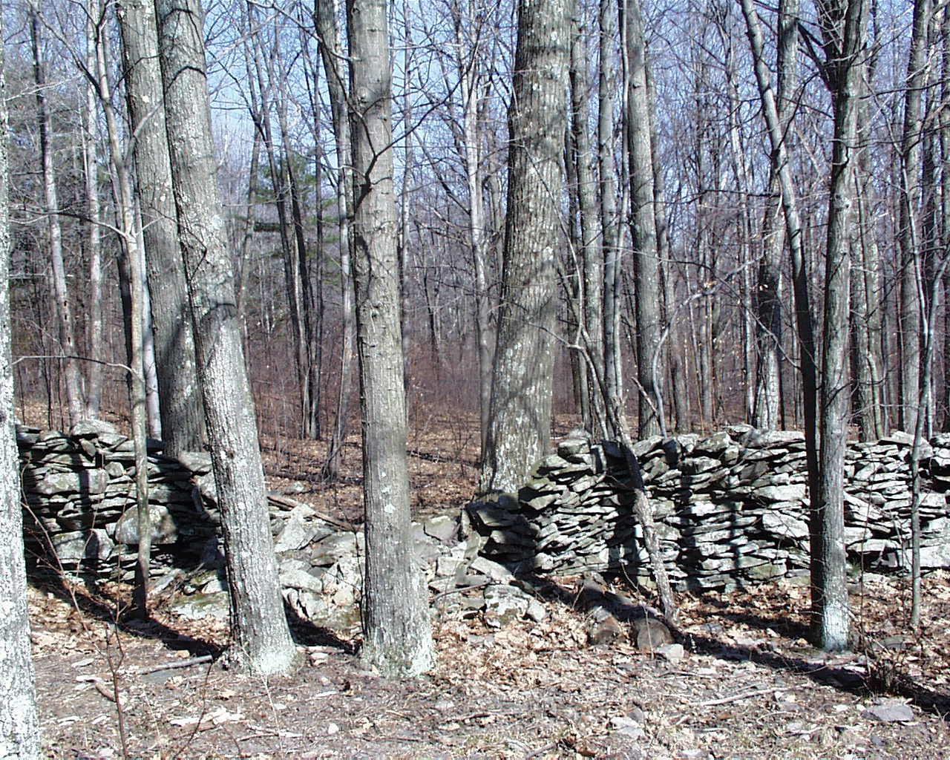
Where do ticks live?
In the woods.

Slide 8
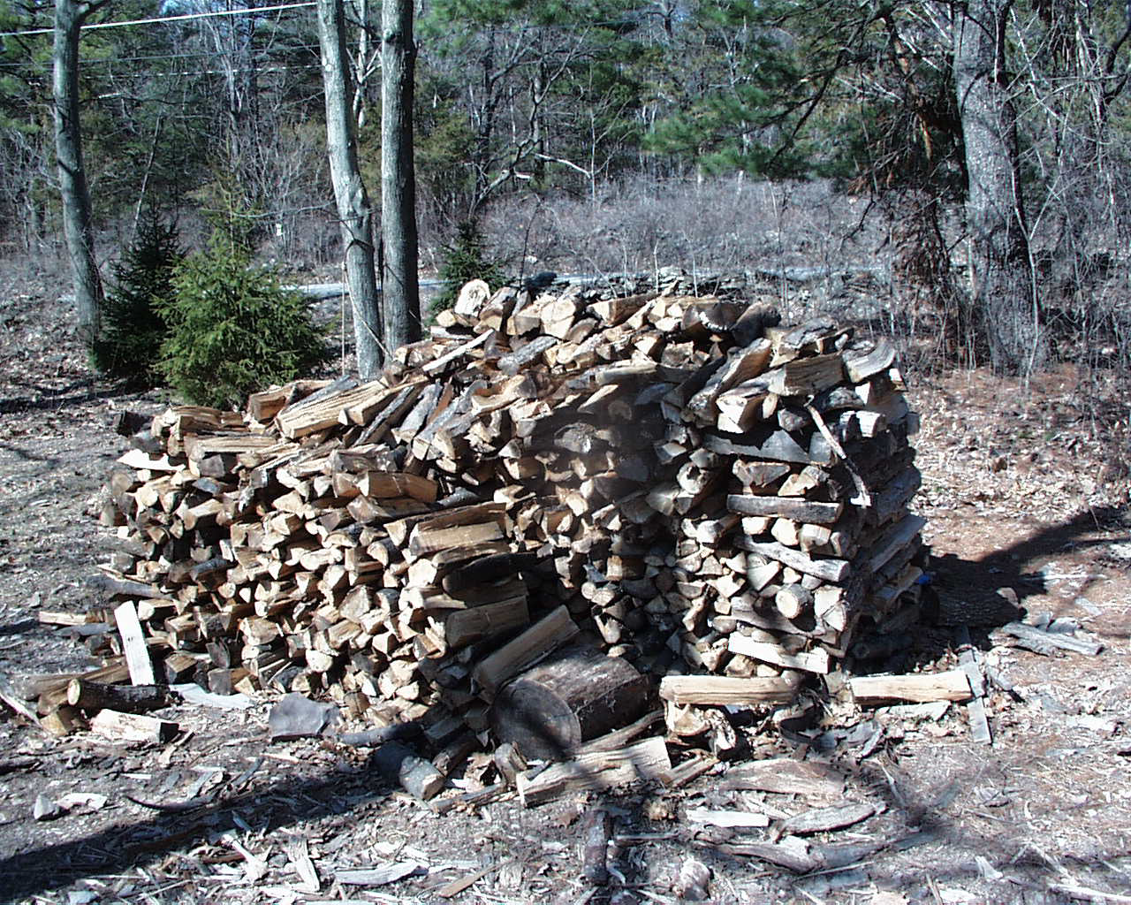
Where do ticks live?
Where the rodents live.

Slide 9
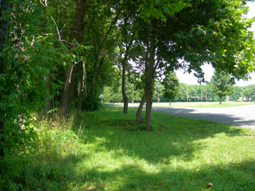
Where do ticks live?
The edge where lawn meets woods.

Slide 10
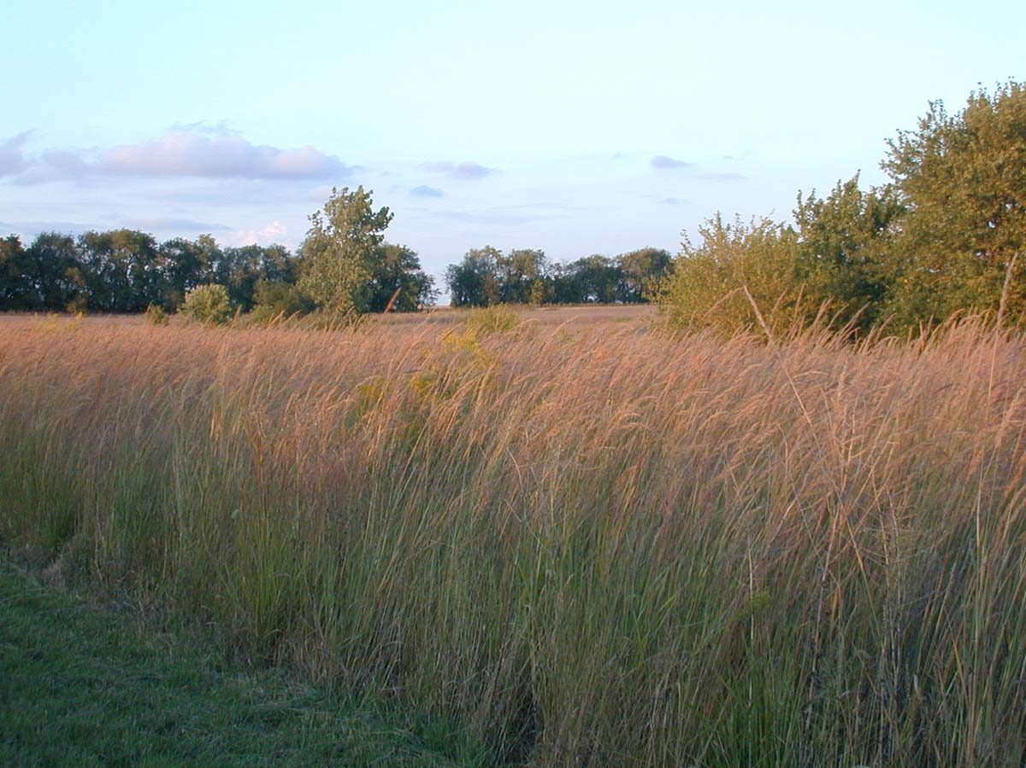
Where do ticks live?
In the tall grass and brush.

Slide 11
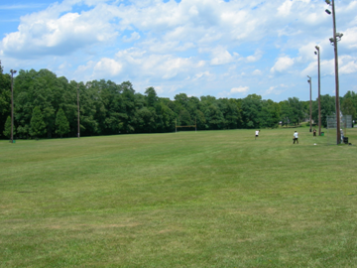
Usually not in the short grass.
However…

Slide 12
However,
80% of tick bites happen on home lawns or landscapes.
95% in same Postal Code.
(Dr. Kirby Stafford, Connecticut Agricultural Experiment Station, Oct. 2016)

Slide 13
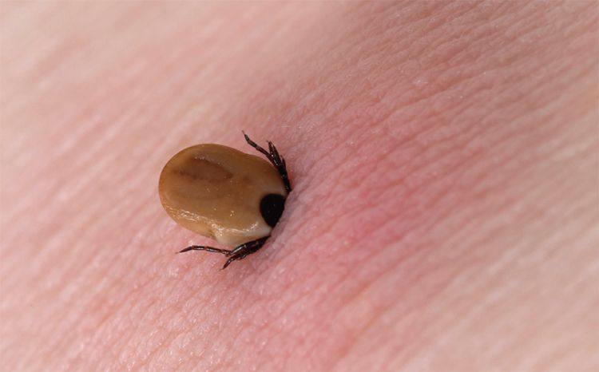
Got Ticks?

Slide 14

Who You Gonna Call?

Slide 15
Tick Busting
Promptly removing a tick may reduce the likelihood of contracting tick-borne diseases.
It takes time for ticks to insert mouthparts and secrete attachment cement, which hardens and further anchors the tick. The sooner you remove it, the easier it is.
After tick removal, disinfect the bite wound.

Slide 16
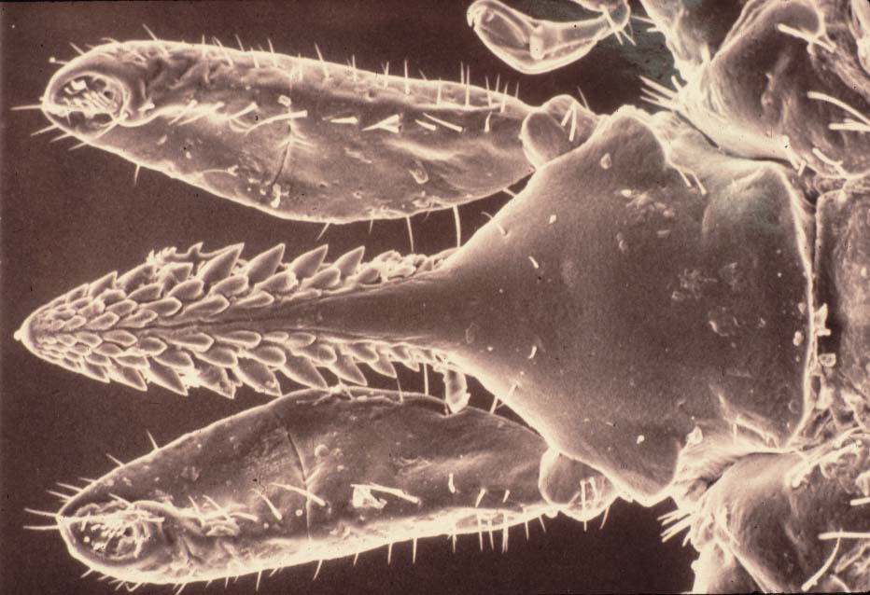
Black-legged tick mouth parts

Slide 17
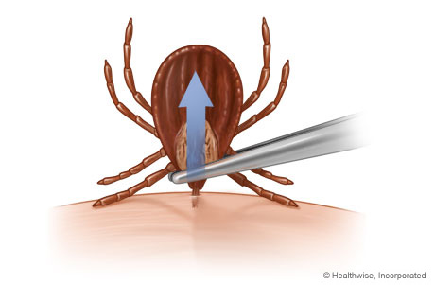
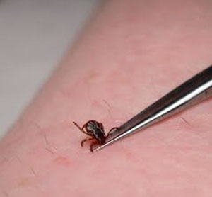
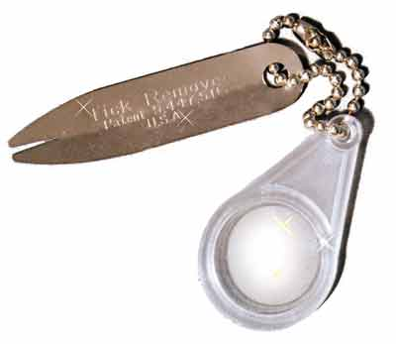
Correct Removal

Slide 18
“Grasp tick as close to the skin as possible…Hmmm”

Slide 19
Correct Removal
Grasp tick as close to the skin as possible and pull gently and slowly.
Do not twist or jerk the tick (CDC). Do not squeeze the body, as this may cause regurgitation, which increases the chance of disease transmission.

Slide 20
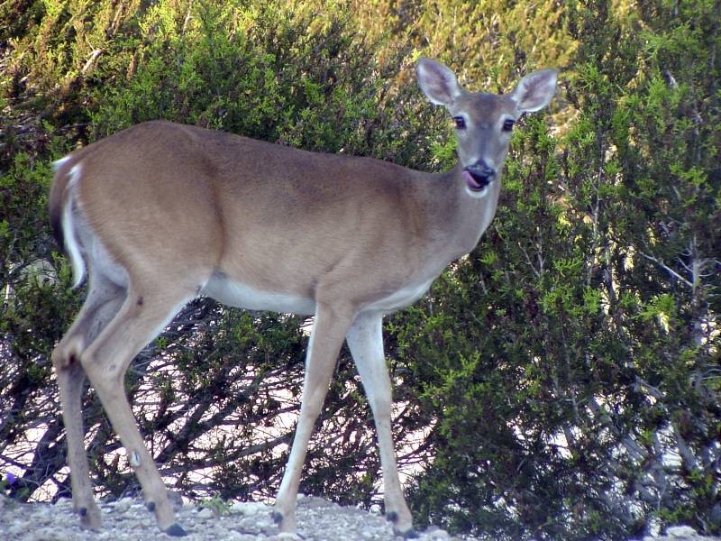
Where Are Deer Ticks Found?
(Not necessarily the obvious answer)

Slide 21
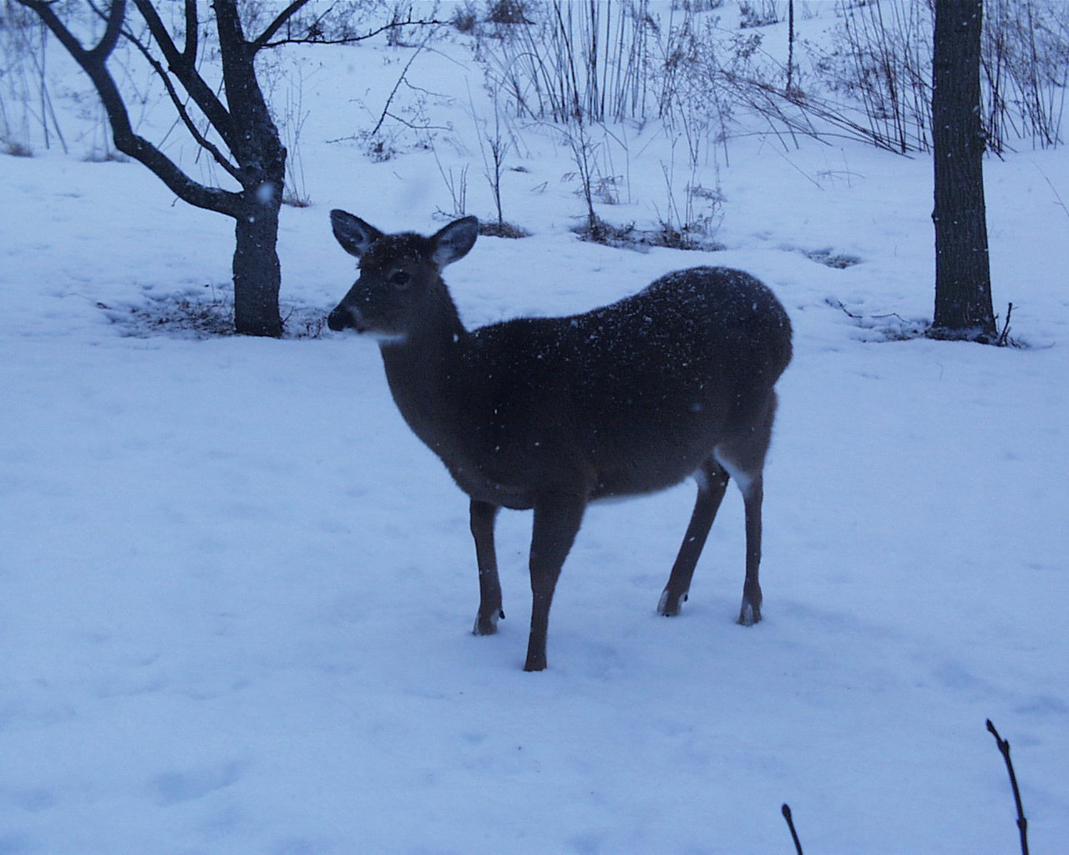
Most adult ticks (over 90%) feed on deer at some point in their development.

Slide 22
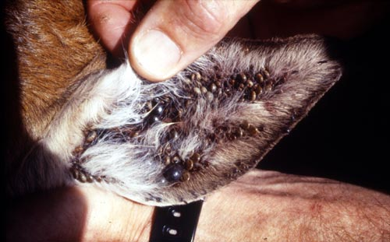
Appetite Suppressant…

Slide 23
But deer do not transmit the Lyme pathogen—they are just tick farms.

Slide 24
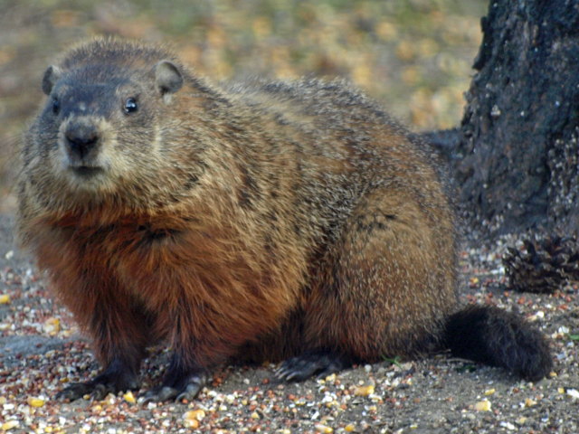
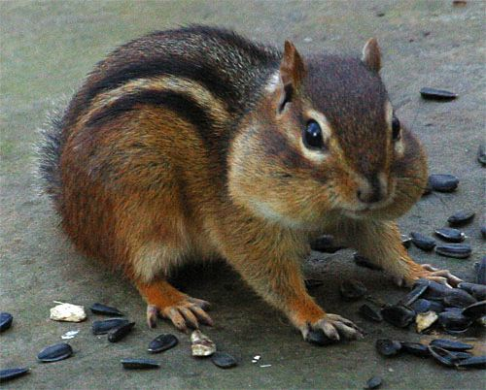
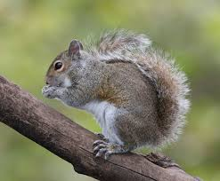
Many other culprits do vector Lyme

Slide 25
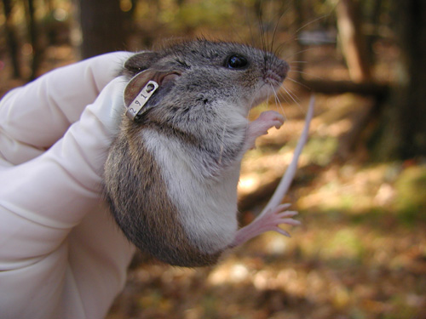
White-Footed Mice are the primary reservoir of Lyme disease (just look for the ear tags…)

Slide 26
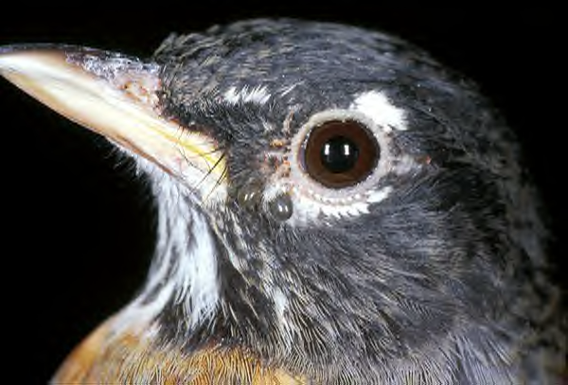
American robin with 2 attached deer tick nymphs
Provided by: CDC

Slide 27
The Vectors

Slide 28
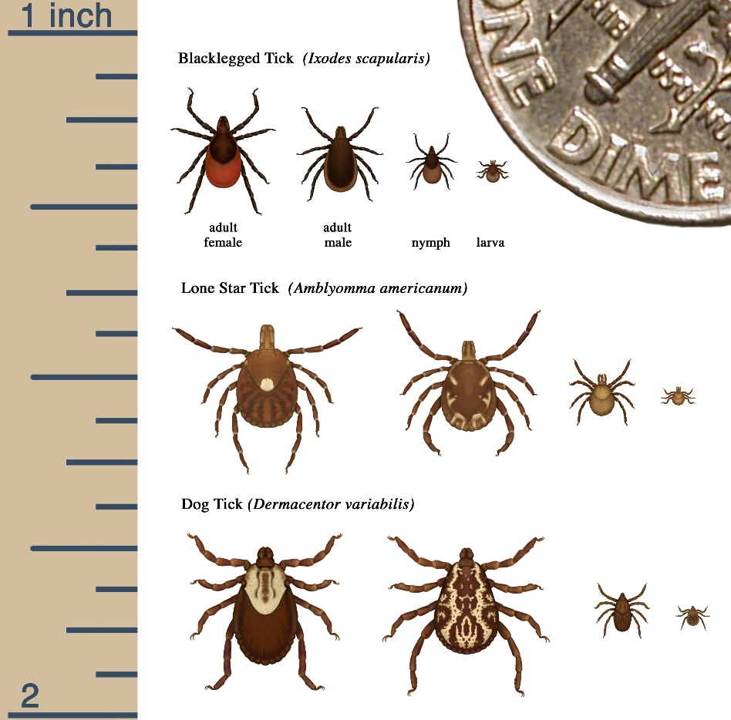

Slide 29
AND

Slide 30
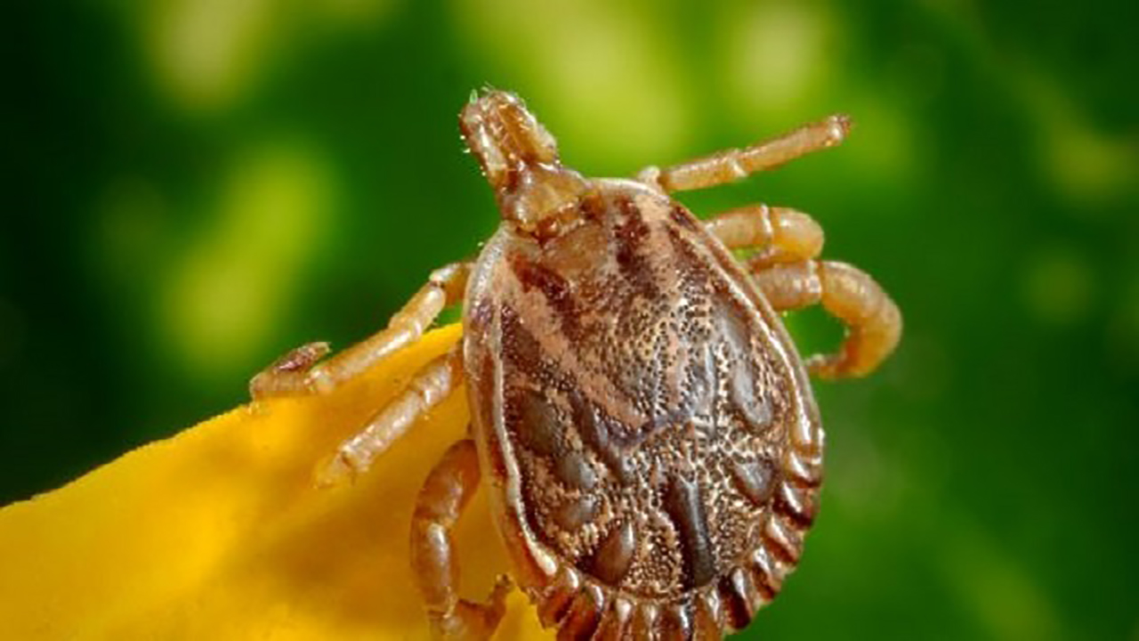
Asian Longhorned (Cattle) Tick NJ 2017, NYS July 2018
In its home range, carries numerous human pathogens.
So far, no infected Asial Cattle Ticks found in North America.

Slide 31
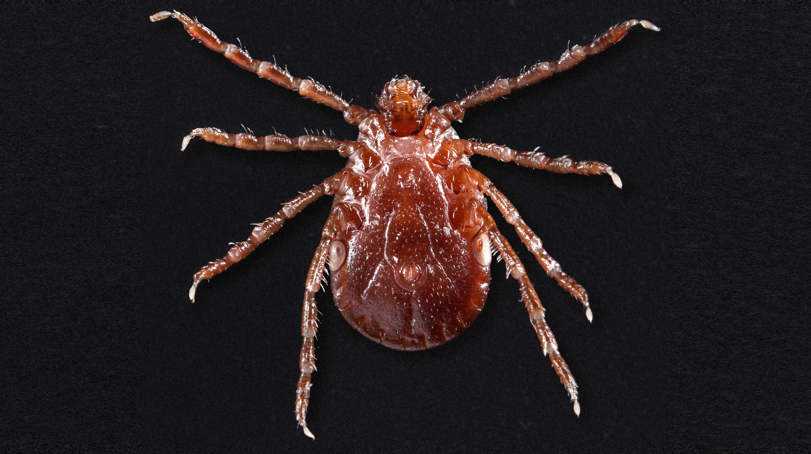
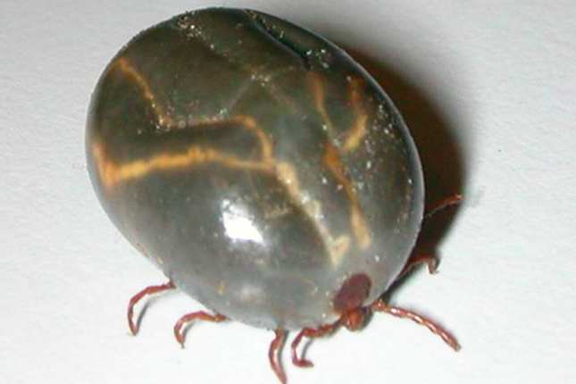
Asian Cattle Tick, Female Before/After Feeding

Slide 32
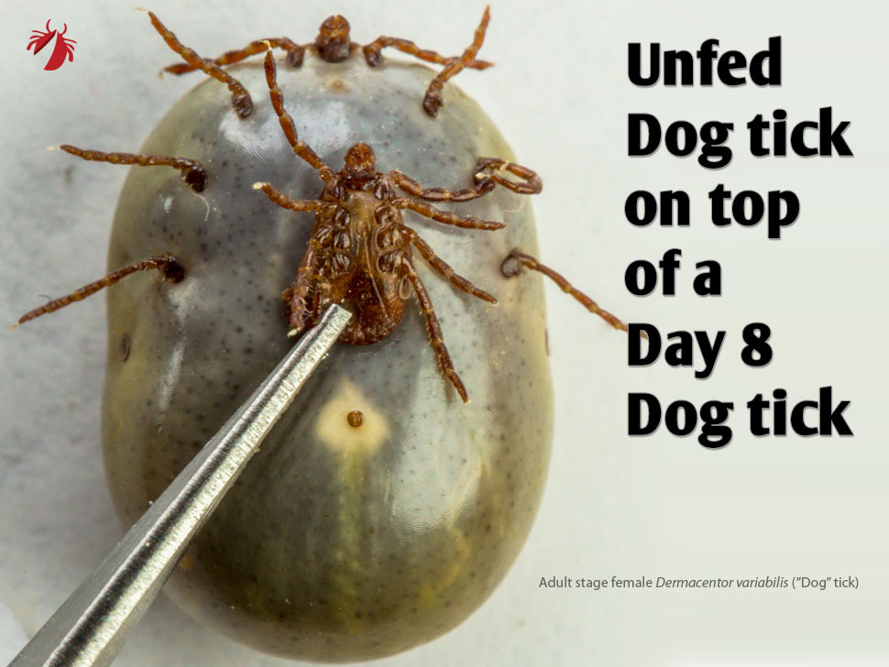

Slide 33
Tick-Borne Illnesses

Slide 34
Lyme disease: Transmitted by blacklegged, a.k.a. deer ticks (Ixodes scapularis); Caused by Borrelia burgdorferi, Borrelia mayonii, and Borrelia miyamotoi.
Anaplasmosis: Transmitted by blacklegged ticks.
Babesiosis: Microscopic parasite, Babesia microti, infects red blood cells. Transmitted by blacklegged ticks. Common in NNY. (NYSDOH, 2014)
Ehrlichiosis: Transmitted by lone star ticks (Ambylomma americanum).
Heartland virus: Possibly transmitted by lone star ticks.
Powassan disease: Transmitted by blacklegged ticks and the groundhog tick (Ixodes cookei). 50% Mortality rate.
Tularemia Transmitted by dog ticks (Dermacentor variabilis), wood ticks (Dermacentor andersoni), and lone star ticks.
Alpha-Gal Allergy: Transmitted by lone star ticks.

Slide 35
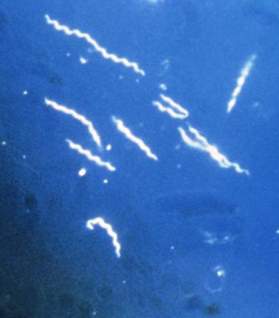
Borrelia burgdorferi spirochete bacterium
1975, Lyme, CT gave rise to the name Lyme disease.
5,300-year-old mummy of Ötzi the Iceman contains Lyme DNA

Slide 36
And now, meet 2 newcomers which cause illness similar to/same as Lyme:
Borrelia miyamotoi (2013)
Borrelia mayonii (2016)

Slide 37
CDC reports there are about 300,000 “confirmed” new Lyme cases each year in the US. This may be 1-10% of the actual number of infections.
The number of other tick-borne illnesses is not well tracked.

Slide 38
TRANSMISSION

Slide 39

Oops…

Slide 40
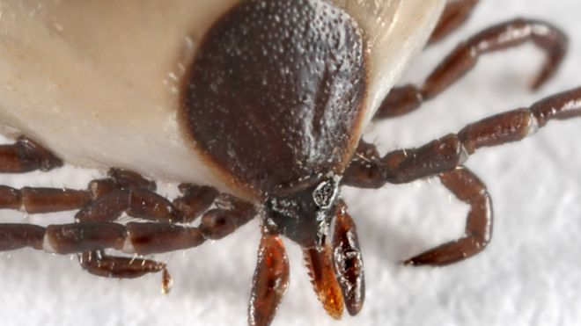
Lyme Transmission
Blacklegged tick, definitely
Insect bites, rarely
Sexually transmitted, possibly (Journal of Investigative Medicine, 01/14)
Congenital, highly unlikely

Slide 41
Lyme Transmission
In NNY, about 60% of adult deer ticks carry B. burgdorferi (Dr. Stephen M. Rich, Umass Amherst, May 2019)
The longer a tick feeds, the greater the infection risk—less than 24 hrs. is “low risk,” but after 24 hrs, infection may occur (Stafford, 2016)
Other tick-borne diseases can be transmitted in just a few minutes! (Stafford, Zubcevik, 2016)
Nymph stage is more likely to infect
Infected females may lay eggs infected with B. burgdorferi and definitely can lay eggs infected with B. miyamotoi (Stafford, 2016)

Slide 42
How Attractive Are You?
There is evidence that individuals vary a lot in terms of attracting ticks. It is not yet known why.
Just because you do not see many ticks on you does not mean ticks should be discounted.

Slide 43

SYMPTOMS

Slide 44
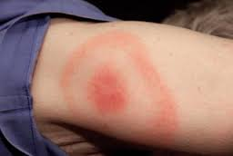
Erythema Migrans (Expanding “bull’s-eye rash”)
Only about 20% of Lyme cases get this rash!
(Smith et al, Annals of Internal Medicine, 2002 136:142-148; also Dr. Nenevah Zubcevik, Lyme Specialist, Harvard Med School, 2016 lecture)

Slide 45
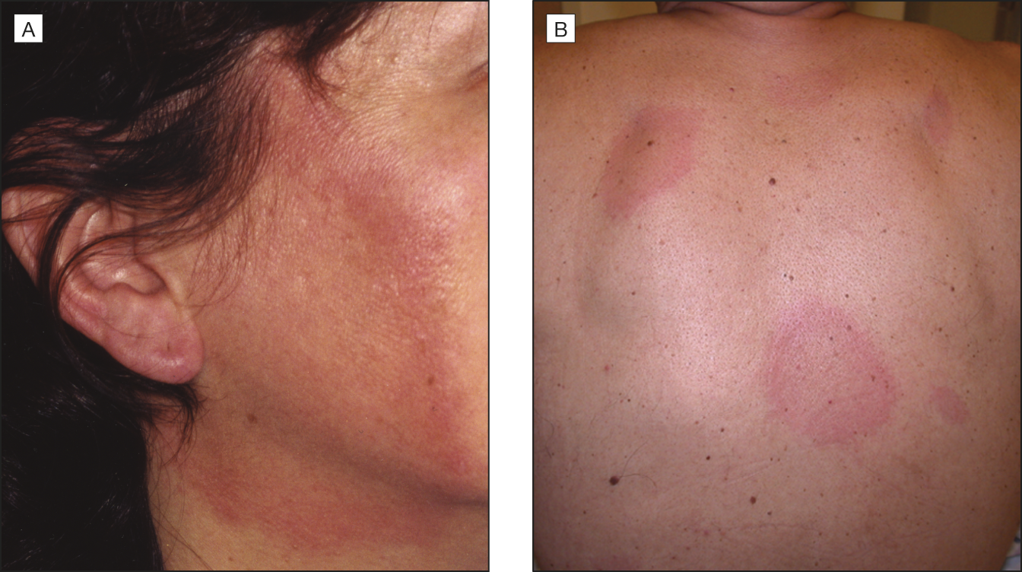
A lot of variation in appearance

Slide 46
Initial Symptoms Vary WILDLY
Joint pains, chills, fever, and fatigue can be transient, but may recur as the disease progresses.
Debilitating fatigue, stiff, aching neck, tingling or numb extremities, facial palsy (paralysis) may occur.
Cardiac issues, confusion, short-term memory loss, inability to concentrate, severe headache, arthritis/ joint swelling, dizziness, mental "fog“ CAN OCCUR RIGHT AWAY, or may present weeks, months or even years after a tick bite.

Slide 47
Late Persistent Infection
Untreated or inadequately treated patients may develop severe and chronic symptoms affecting the brain, nerves, eyes, joints and heart.
About 10-20% of people not treated with antibiotics will develop chronic arthritis.
Problems with memory or cognition, fatigue, headache, and sleep disturbances may persist after treatment.

Slide 48
NIH-Sponsored Studies
“Research studies suggest that people who suffer from post-Lyme disease symptoms may be genetically predisposed to develop an autoimmune response that contributes to their symptoms.”
“Researchers also are trying to find out the best length of time to give antibiotics for the various symptoms of Lyme disease.”

Slide 49
Early Diagnosis and Treatment
The sooner treatment begins, the quicker and more complete your recovery.

Slide 50
WHO IS MOST AT RISK
For Delayed Diagnosis/ Misdiagnosis?
Under 5 Years Old
Over 75 Years Old

Slide 51

Testing

Slide 52
NOT an exact science!
Enzyme-linked immunosorbent assay (ELISA) 65% sensitivity
Western Blot (2-part)
Polymerase chain reaction (PCR)—TBA
Tick-Borne Disease Serochip—TBA
Western Blot Results:
False-positive: 3%
False-negative: at least 36% (Journal of Clinical Infectious Diseases, 07/2008), but may be >60% (Zubcevik, 2016)

Slide 53
Many distinct strains of Borrelia burgdorferi do not show up on Western Blot test. (Kirby, Zubcevik 2016)
B. miyamotoi and B. mayonii do not show up. (“”)
Dr. Zubcevik: 69% of Lyme cases are not diagnosed in a timely manner.

Slide 54
Western Blot Facts You Should Know
Checks for immunoglobulins associated with protein segments (“bands”) known to be on one strain of Borrelia burgdorferi
2-Part: IGG for previous (“gone”) and IGH for active (“home”) infections
IT IS NOT A YES/NO TEST!
Of patients with acute culture-proven Lyme, 20–30% remain seronegative on serial western blot sampling.
Each lab tests for a different quantity of bands, and place emphasis on varied bands
Each lab differs in threshold for “positive” result: some consider the presence of >2 bands positive; others use >3 as the trigger

Slide 55
More on the Western Blot Test
“There are no standard criteria for the interpretation of the Western Blot test for Lyme disease.
Some laboratories simply look for four or more designated bands whereas other laboratories require a specific pattern of reactive bands.”
“Recent studies have shown that there is sufficient genomic and phenotypic heterogeneity among the strains commonly known as B burgdorferi to warrant their division into three genospecies”
(The Canadian Journal of Infectious Diseases 4(2): 115–116.)

Slide 56
And Still More…
“Lyme disease should be diagnosed clinically, without reliance on testing. However, all too often, physicians will ignore clinical presentations if laboratory tests are negative. Yet there are numerous scientific articles documenting false negatives and low sensitivity of such tests.”
“Lyme bacteria are not always present in the blood. The person could have been infected with a strain of Bb that is not covered in testing.”
(Dr. Daniel Cameron, MD, MPH, nationally recognized Lyme and tick-borne illness expert)

Slide 57
NB:
The National Guidelines Clearinghouse, a federal database that provides treatment information to health care professionals and insurance companies, has removed the Infectious Diseases Society of America Lyme treatment guidelines from its website and only lists the ILADS guidelines.

Slide 58
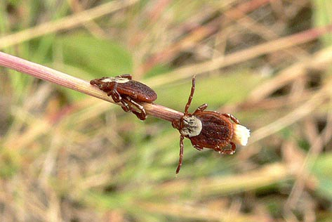
Prevention

Slide 59
Take the road most traveled.
Walk on cleared trails and avoid brushing up against vegetation and tall grass. Avoid game trails.
Dress like an absolute nerd. Clothing should be light in color to allow you to spot crawling ticks more easily.
Wear closed-toe shoes, long socks & pants, & long-sleeved shirt.
Tuck pant legs into the socks, tuck shirt into pants to slow crawling ticks. Apply repellant.
CYA.
Avoid sitting on the ground or on stone walls.

Slide 60
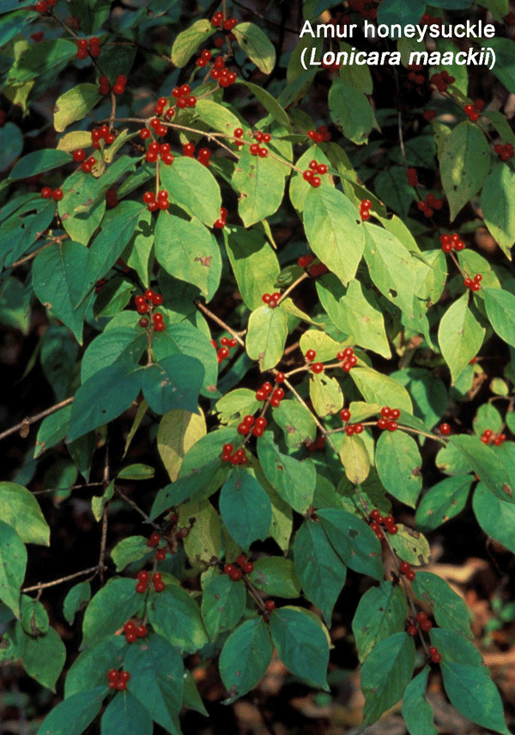
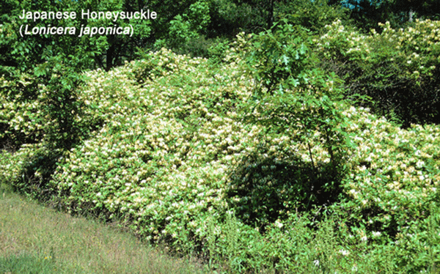

Slide 61
Invasive honeysuckle bushes have the highest tick density of any shrub surveyed…

Slide 62
Repellants
DEET can be applied directly to the skin or clothing. Follow label directions!
Permethrin (a synthetic pyrethroid) cannot be applied directly to the skin. It should be applied to clothing and allowed to dry before the clothes are worn.
Picaridin Less toxic than DEET
Botanical Repellents do not provide the same degree of protection (0-30%). Active ingredients of these products include: oil of citronella, oil of eucalyptus and nootkatone (from essential oil of grapefruit).
Damminix tick tubes have cotton balls treated with permethrin. One 8-year study showed a 90% decrease in tick population. (Ecohealth INC., 1990-1998)

Slide 63
Do a full-body tick check at the end of the day
Waist/ belt line
Sock hem
Under the arms
Back of the knees
Between the legs
In and around the ears
In and around the hairline
Inside belly button

Slide 64
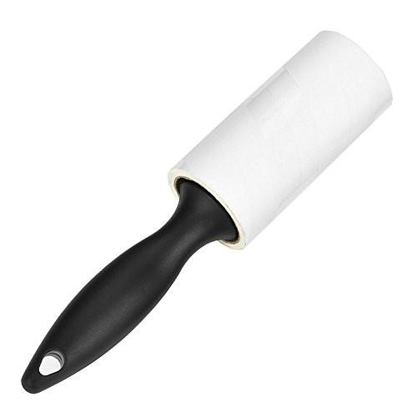
Lint Rollers Are Awesome

Slide 65
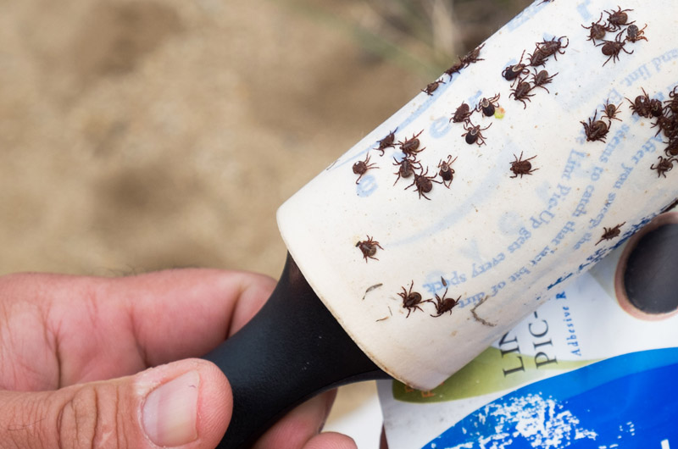

Slide 66
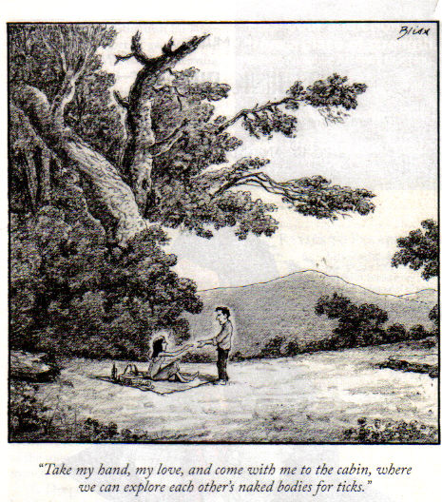

Slide 67
More Tips
Check your pets after they come indoors.
Ticks can potentially survive hot/cold wash cycle, but one hour on high heat in the dryer killed all stages of ticks.
Do not combine steps 1 and 2…

Slide 68
Resources
https://www.ilads.org/
http://www.cdc.gov/lyme/
https://www.niaid.nih.gov/topics/lymeDisease/
https://www.huffingtonpost.com/dana-parish/yale-trained-doctor-refut_b_11291116.html

