Slide 1
Paul Hetzler
Cornell Cooperative Extension
of St. Lawrence County
ph59@cornell.edu
+1(315) 379-9192 ext. 232

Slide 2
Introduction to Lycorma deliculata: Spotted Lanternfly
Forest-Pest Identification & Management Course
16 January 2019 Canton, NY
Paul Hetzler
Cornell Cooperative Extension of St. Lawrence County
ph59@cornell.edu (315) 379-9192 ext. 232
Special thanks to:
Sven-Erik Spichiger,

Slide 3
Spotted Chinese Lanterns = Good.

Slide 4
Spotted Chinese Lanternfly = Bad.

Slide 5
What is Lycorma deliculata ?
Native to China, Bangladesh, Vietnam; invasive in Japan, South Korea, N. America
Not a lantern, or a fly, or even a moth. It’s a plant hopper in the order Hemiptera, or “true bugs.”
Favors Ailanthus or Tree-of-Heaven, also loves Vitis and Acer spp., and all members of the Rosaceae family, but will feed on nearly anything, including herbaceous plants. It inserts its rostrum into phloem tissue and withdraws sap.
Favorite forest host after Ailanthus: Maple
A commuter.
Incredibly fecund; overwhelms trees with high populations.
First discovered in September 2014 in Pennsylvania; now in 7 US States.
Likely came as egg masses on a pallet of stone from China.

Slide 6
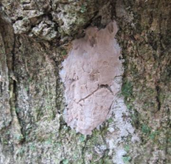
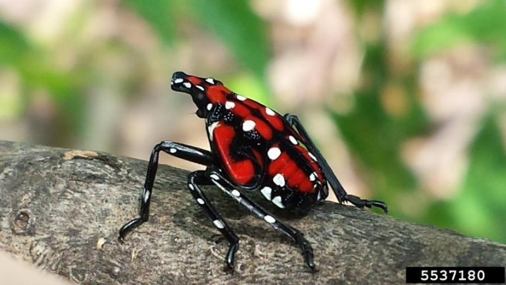
The Particulars
One Generation Per Year Eggs laid Mid-October-late November
Egg masses can be found October-June Females seek rough surfaces: rusty metal, rocks, trees
Shiny at first, become dull
Hatchlings emerge mid-May
to early June
Fourth instar gets a red paint job.
Also grows a brain—more on that later.

Slide 8
Egg masses—often well-hidden

Slide 10
Egg cases become dull over time, making them harder to see.

Slide 11
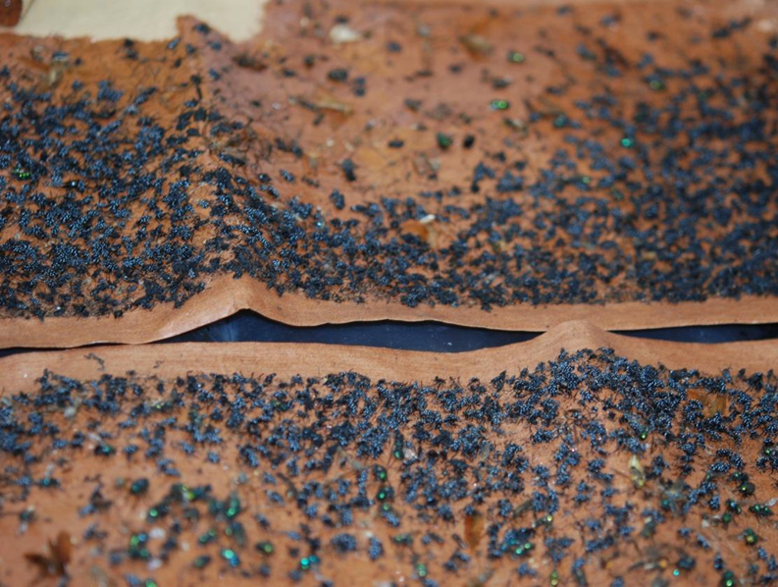
Immature stages migrate up & down trunks each day & are easily caught on sticky bands
BUT, 4th instars & adults WILL NOT step on bands.

Slide 12
2nd and 4th instar lanternfly nymphs

Slide 13
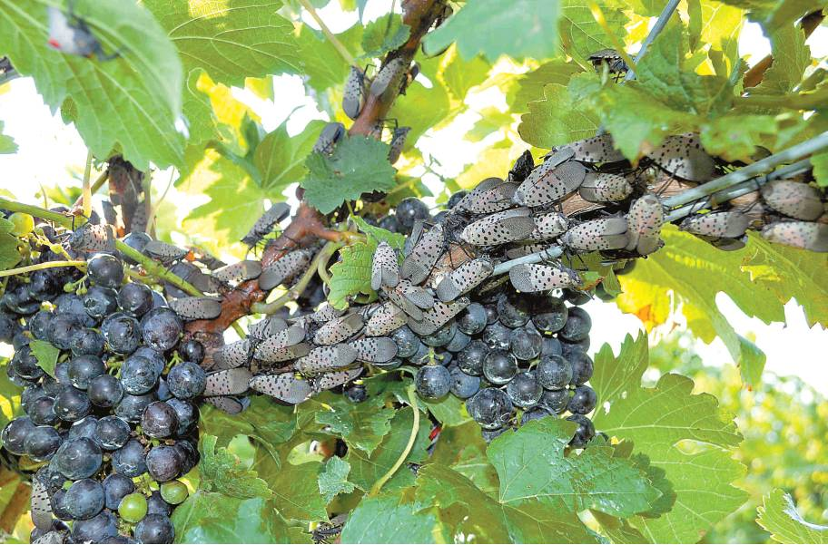
Typical adult feeding pattern

Slide 14
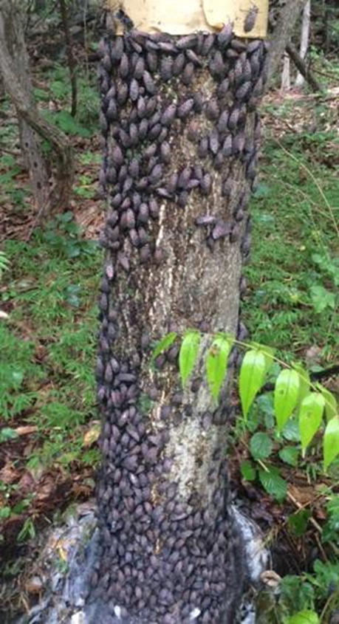
Commuters

Slide 15
WE WILL SEE THIS PEST IN THE NEAR FUTURE! In 2016, spotted lanternfly was restricted to four Pennsylvania counties. By 2018, it had spread to 6 States.
At the close of 2017, no SLF had been found in NYS. By October 2018, eight SLF specimens were found in six NYS Counties.

Slide 16
Confirmed SLF finds as of December 2018

Slide 17
THE BAZILLION-DOLLAR QUESTION:
Can Lycorma deliculata successfully reproduce without at least once feeding on Ailanthus?
Here’s a handy flow chart:
IF NO:
Hooray! All we need to do is keep Ailanthus from establishing here. Whew—dodged that bullet!
IF YES:
Aw, sh--!
Because lanternfly has a sweet tooth, or rostrum, it will head right for the nearest maples & fruit trees. We cannot afford to gamble—we need to spread the word, and be vigilant.

Slide 18
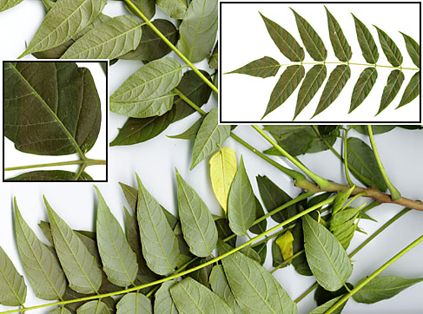
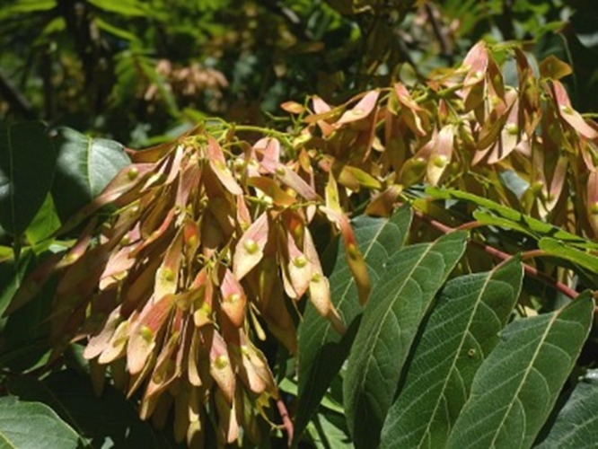
Ailanthus altissima, “Tree of Heaven”
Highly invasive, toxic
Preferred host for Lycorma
Hardy to USDA Zone 5a (much of NNY)
Often an urban “weed tree”
Compound leaves
Sometimes confused with sumac, walnut

Slide 21
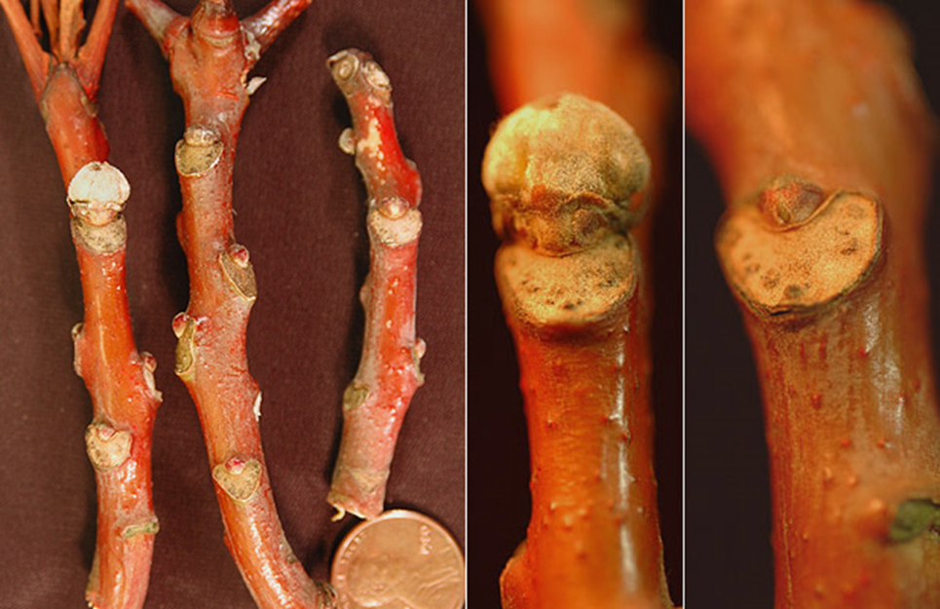
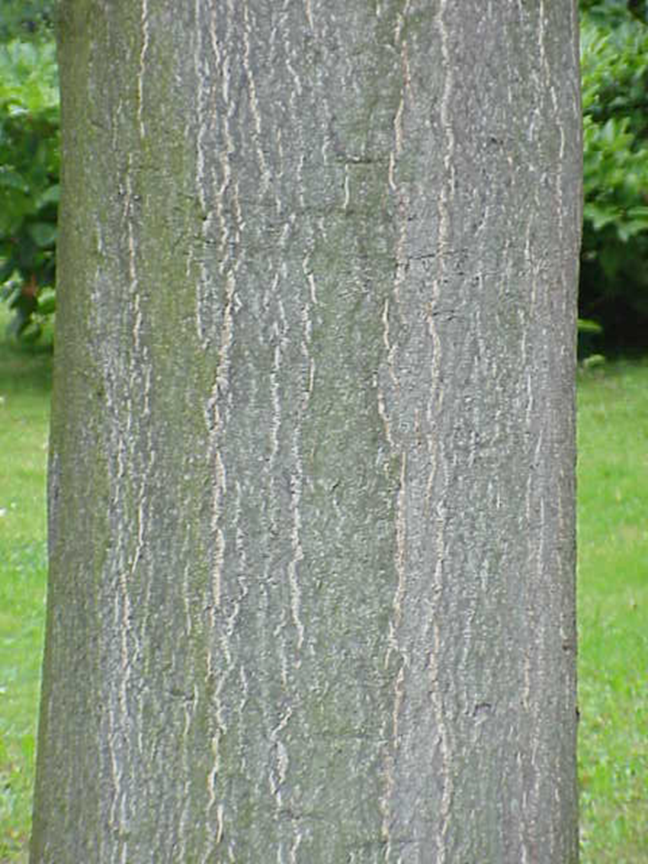
SLF may or may not require Ailanthus for successful reproduction…fingers crossed—and management plan in place!

Slide 22
Host-Tree Study
Platanus occidentalis
Sycamore
Populus grandidentata
Big-toothed aspen
Prunus serotina
Black cherry
Quercus prinus
Chestnut Oak
Quercus rubra
Red Oak
Salix spp.
Willow
Sassafras albidum
Sassafras
Tilia americana
Linden
Ulmus rubra
Slippery elm
Vitis spp.
Grape
Acer palmatum
Japanese maple
Acer platanoides
Norway maple
Acer rubrum
Red maple
Acer saccharum
Sugar maple
Ailanthus altissima
Tree-of-heaven
Amelanchier canadensis
Serviceberry
Betula lenta
Black birch
Betula papyrifera
Paper birch
Carya glabra
Pignut hickory
Carya ovata
Shagbark hickory
Fagus grandifolia
Beech
Fraxinus americana
White ash
Juglans nigra
Black walnut
Liriodendron tulipifera
Tulip poplar
Nyssa sylvatica
Black gum

Slide 23
Host -Tree Favorites Everyone loves maple! Unfortunately.
Mean SLF/Tree
Species
n
A. platanoides
4
46.5
A. saccharum
15
16.667
Ailanthus
69
80.145
B. lenta
14
77.857
F. americana
9
34.778
J. nigra
2
44.5
L. tulipifera
11
31.091
N. sylvatica 4 81
Average number of SLF per tree

Slide 24
Cultural & Mechanical Control & Prevention
Egg-mass scraping
Tree banding
Scouting host trees
Inspection of shipments
Increased biosecurity Oct.-June
Sniffer-dogs?

Slide 25
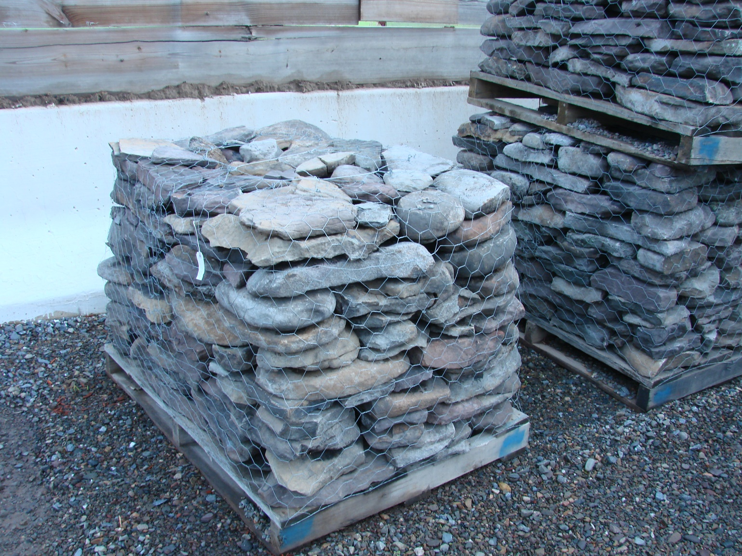
Find your own @%# rocks!

Slide 26
Biocontrol of Lycorma
Julie Gould- USDA
Cooperative agreement with Chinese Academy of Forestry for foreign exploration.
USDA-APHIS has imported into quarantine Lycorma eggs parasitized by Anastatus orientalis.
Current emphasis on rearing Lycorma and the parasitoids and initiating host specificity testing.

Slide 27
Chemical Control
PLEASE NOTE THAT NO PRODUCTS ARE CURRENTLY LABELED FOR USE ON SLF IN NY!
If there is a lanternfly outbreak, NYSDEC likely to issue “2ee” exemption document.
Where Ailanthus is present, it is possible to use them as “trap trees.”
Pennsylvania Department of Agriculture has run trials on:
Pymetrozine (selective for Hemiptera; soil application)
Bifenthrin (broad-spectrum synthetic pyrethroid )
Beauveria bassiana (a naturally occurring fungus )
Dinotefuran (systemic neonicotinoid; basal-bark spray)
Right now, Dinotefuran (Safari) is the go-to pesticide for SLF. The downside is that it is both mobile and persistent, and toxic to pollinators. There is no easy answer. Except maybe to use rocks from your own back yard.

Slide 28
Questions?
Thank you!
http://www.agriculture.pa.gov/Protect/PlantIndustry/spotted_lanternfly

