Slide 1
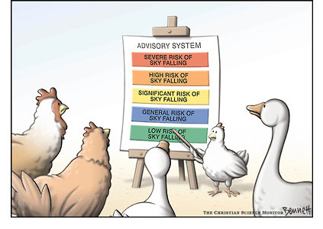
Hard Times for Hard Maples
The convergence of historic stress, dramatic shifts in weather patterns, and periodic defoliation have resulted in unprecedented levels of stress in sugar maples.
Paul Hetzler, ISA Certified Arborist
paul.j.hetzler@gmail.com
(613) 255-4966

Slide 2
Hard Maple = Sugar Maple = Acer saccharum
Norway maple

Slide 3
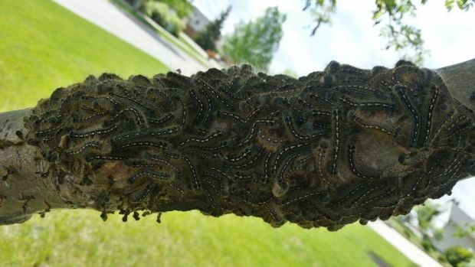
Most recent hard time: Eastern Tent Caterpillar (ETC) & Forest Tent Caterpillar (FTC)

Slide 4
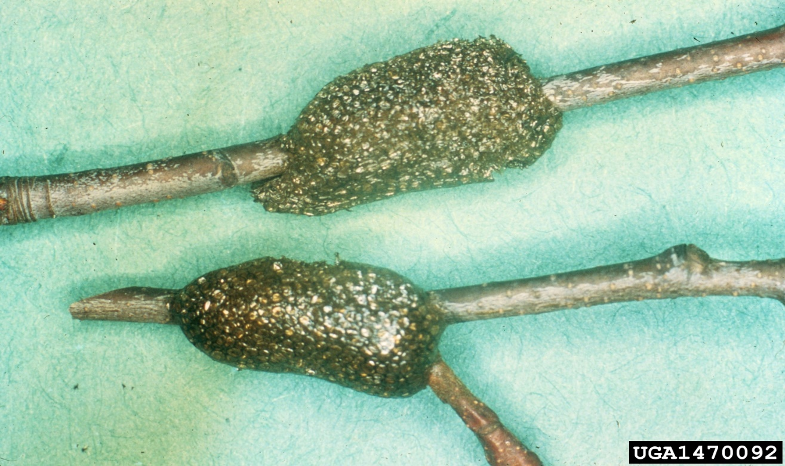
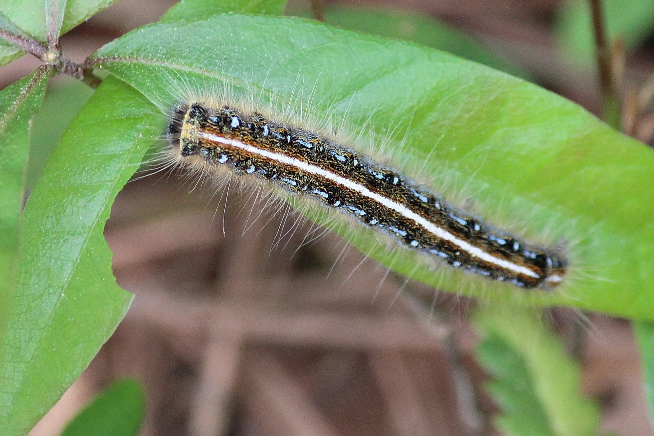
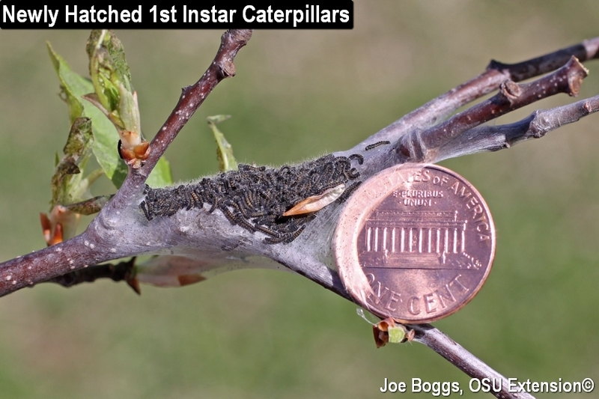
ETC: make “tents” (pennies optional); egg masses more tapered at ends; larvae have “road” down their backs

Slide 5
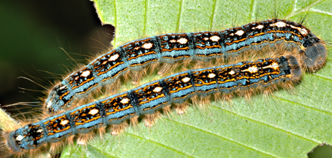
FTC: NO TENTS; egg masses more squared-off at ends; larvae have “footprints” down their backs.

Slide 6
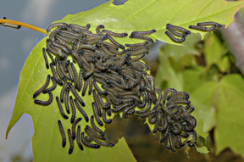
Forest-Tent Caterpillar (Malacosoma disstria) 2nd and 5th instar larvae

Slide 7
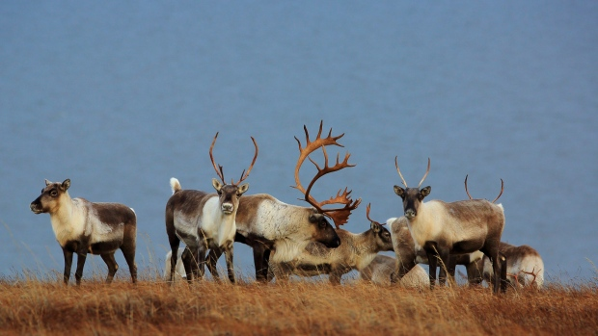
How Many Caterpillars?
“During outbreaks, caterpillar biomass greatly exceeds the collective biomass of all other animals in the forest. Dr. Jens Roland, University of Alberta, estimated the biomass (total weight) of FTC per square kilometer of forest during the peak of an outbreak to be equivalent to that of 657 caribou.” Terence Fitzgerald, The Tent Caterpillars, 1995, Cornell Univ. Press

Slide 8
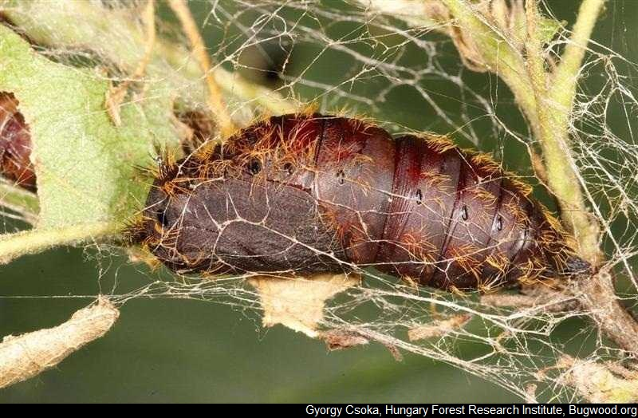
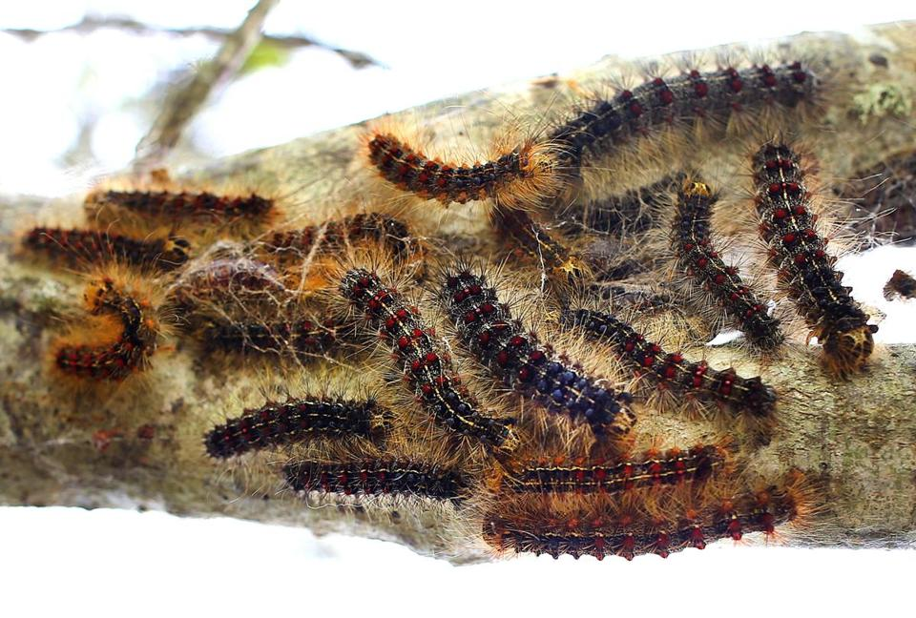
Gypsy Moths: Just to compare with tent-cats.

Slide 9
Some tents are not a problem.

Slide 10
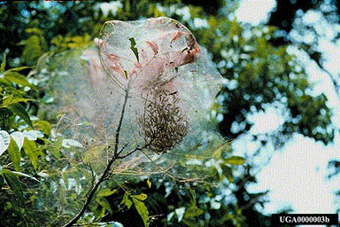
Fall Webworm

Slide 11
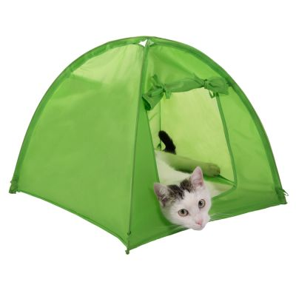
Cat Tents: Unlike tent-cats, they do not pose a significant threat to maples.

Slide 12
Setting the Stage: SUNY-ESF Study Bishop et al, 21 October 2015, Ecosphere
“The last few decades have brought warmer and wetter conditions, typically good for plant growth," said Dr. Colin Beier, associate professor of ecology at ESF who supervised Bishop's thesis research. "Meanwhile, there have been big strides in reducing acid rain, which is especially damaging to sugar maple. Given these changes, we would expect these trees to be thriving, but they are not."
“Outside of studies of red spruce in the 1970s, I have never seen anything quite like this," said study co-author, Dr. Neil Pederson, an ecologist at Harvard Forest in Massachusetts and an expert on tree rings and climate change. "Most tree-ring studies of canopy trees in the region do not show a decline like what we see in these sugar maple. Combined with evidence of reduced natural regeneration of sugar maple in the region, it is a concern."

Slide 13
Enter Sandman: 2012 and 2016 NNY Droughts

Slide 14
Droughts: Not just for the tropics anymore.
noun: drought
1. a prolonged period of abnormally low rainfall or a shortage of water resulting from weather conditions.
synonyms: dry spell, lack of rain, shortage of water

Slide 15
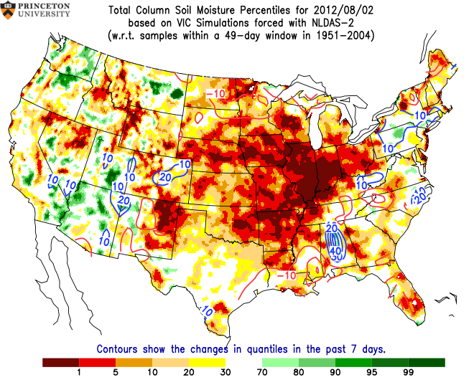
Notes:
8/2/12

Slide 16
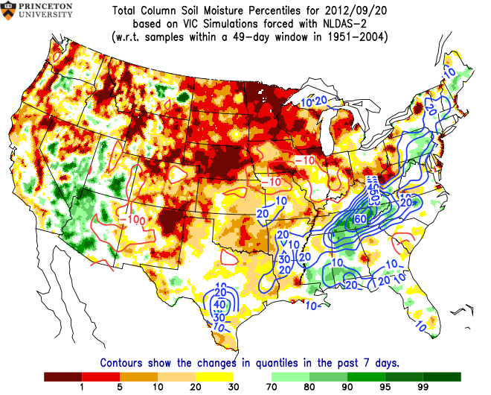
Notes:
9/20/12

Slide 17
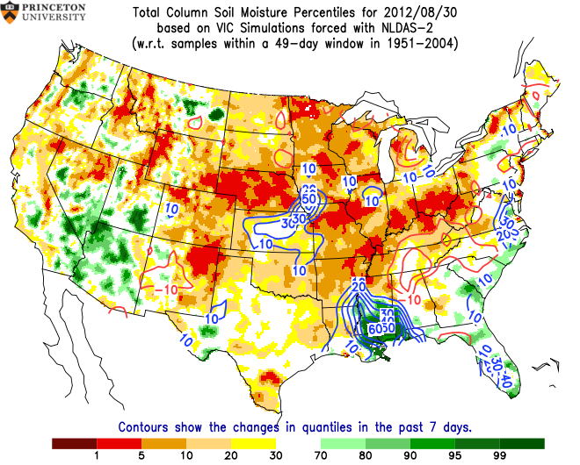
Notes:
8/30/12

Slide 18
Tree Responses to Drought
Root death
Release of stored reserves to replace tissues
Less resistant to disease, decay (CODIT reaction)
Distress crop production in extreme cases
2-3 year recovery period (Hudler)
Lower sugar levels, wood production
Altered chemical signature attracts other forest pests

Slide 19
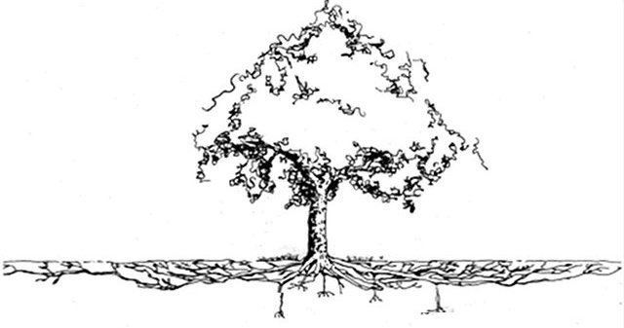

Slide 20
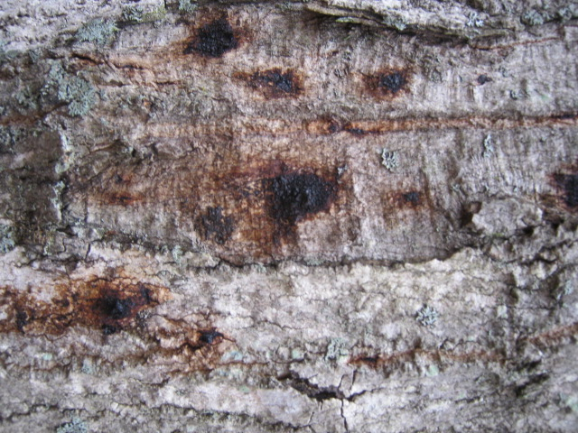
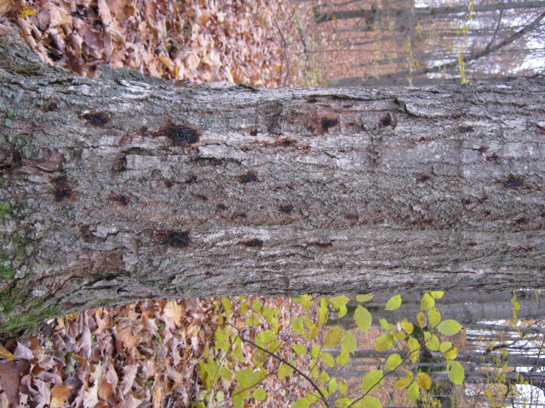
Mystery Bleeding Canker, 2013

Slide 21
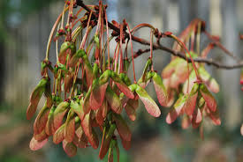
Stress leads to helicopters. Distress Crop vs. Mast Year

Slide 22
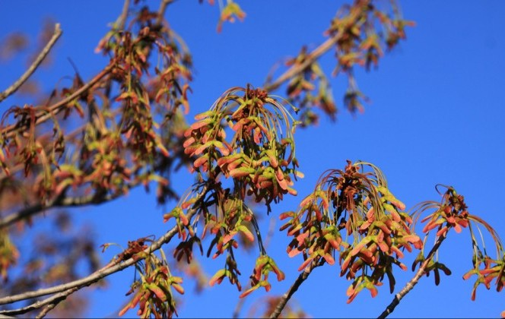
And, helicopters lead to stress…

Slide 23
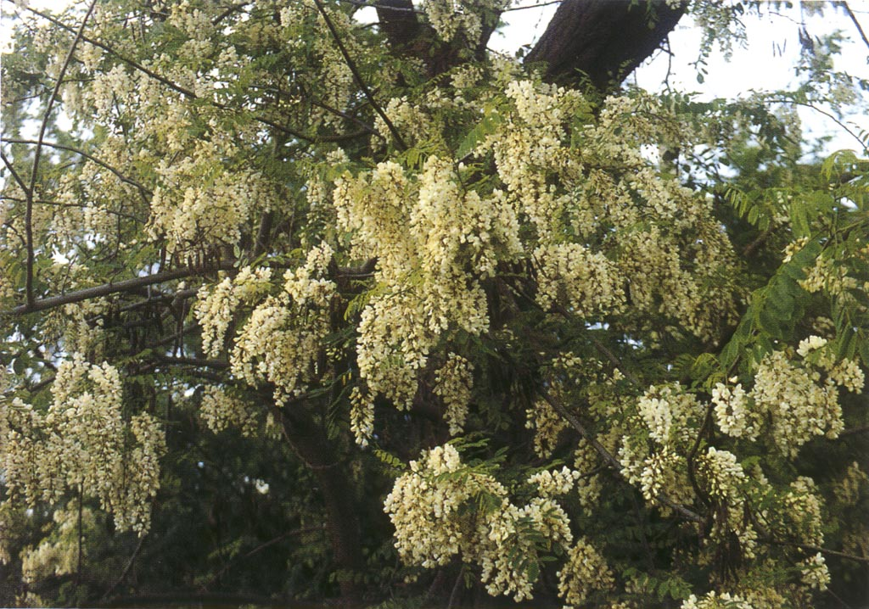
Other tree species affected by distress crops as well.

Slide 24
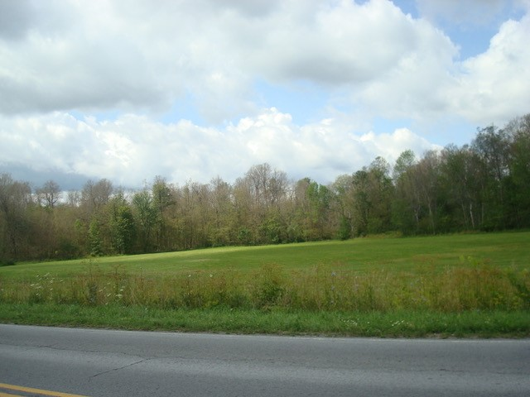
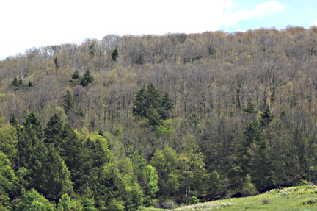
2016: Unprecedented low soil moisture. 2017: Distress Crop, FTC Outbreaks cause further damage.

Slide 25
Christmas in July
According to the NYS DEC, in excess of 200,000 acres of FTC-defoliated maples in NNY DID NOT REFOLIATE to any significant extent. The forest looked like winter from June through October. Minus the snow…

Slide 26
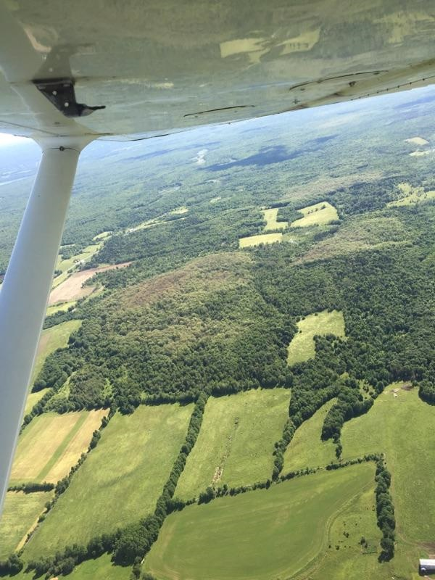
Near Altona: ~1,000 acres affected. Sugar maples are the only species which failed to refoliate.

Slide 27
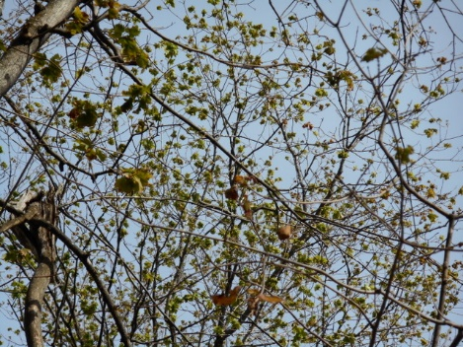
Better late than never? October 27, 2017: leaf-out on South-facing slopes

Slide 29
Note proliferation of adventitious buds. And terminal bud scar spacing for past 5 years… End buds are mush—frozen while still succulent.

Slide 30
Other Stressors

Slide 31
NOOOOOOOO!!

Slide 32
Better…a little.

Slide 33
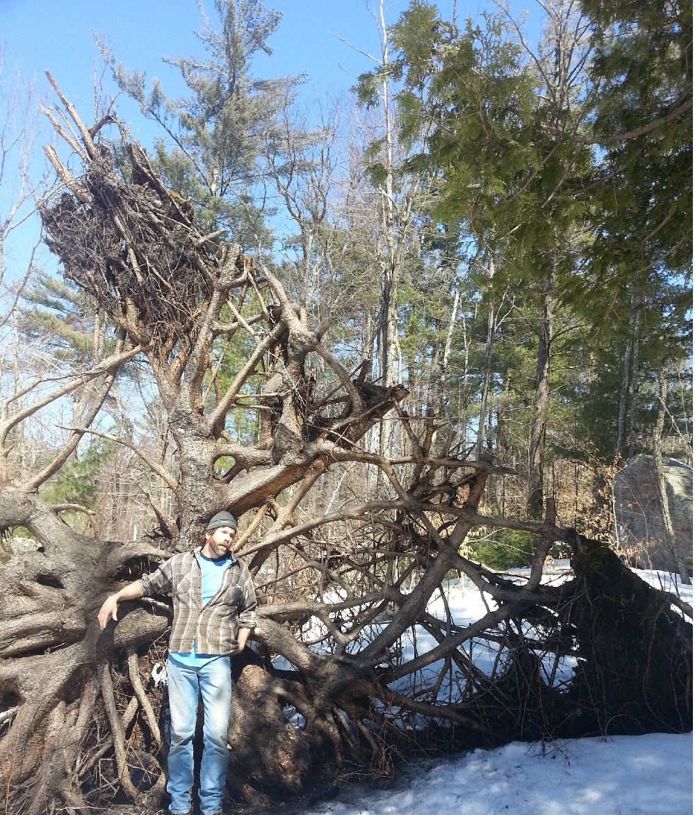

Slide 34
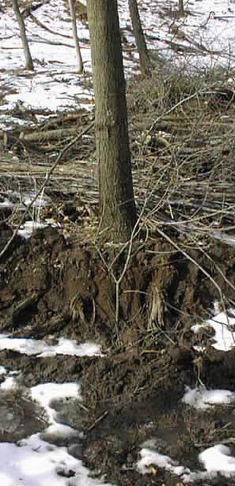
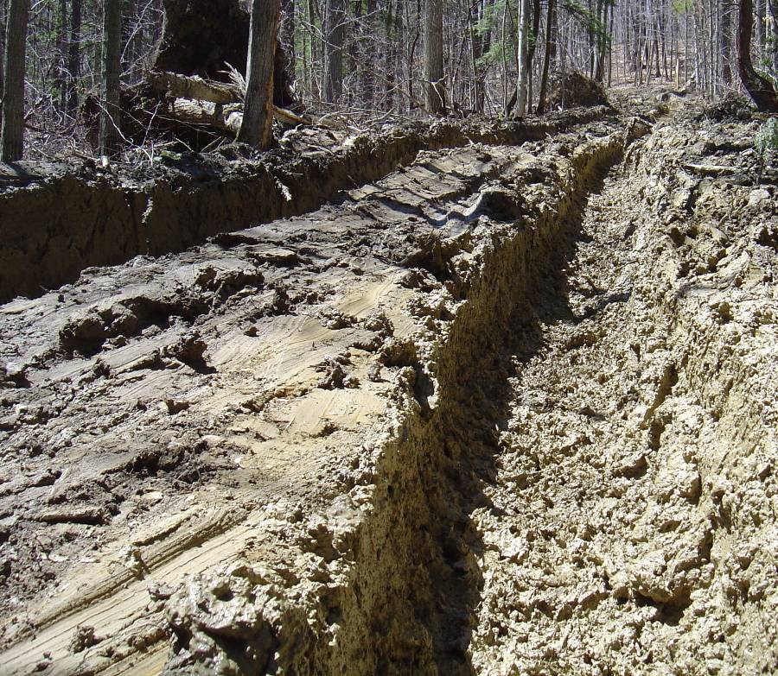
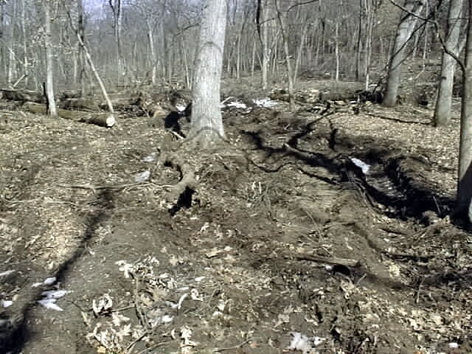
Root-zone damage

Slide 35
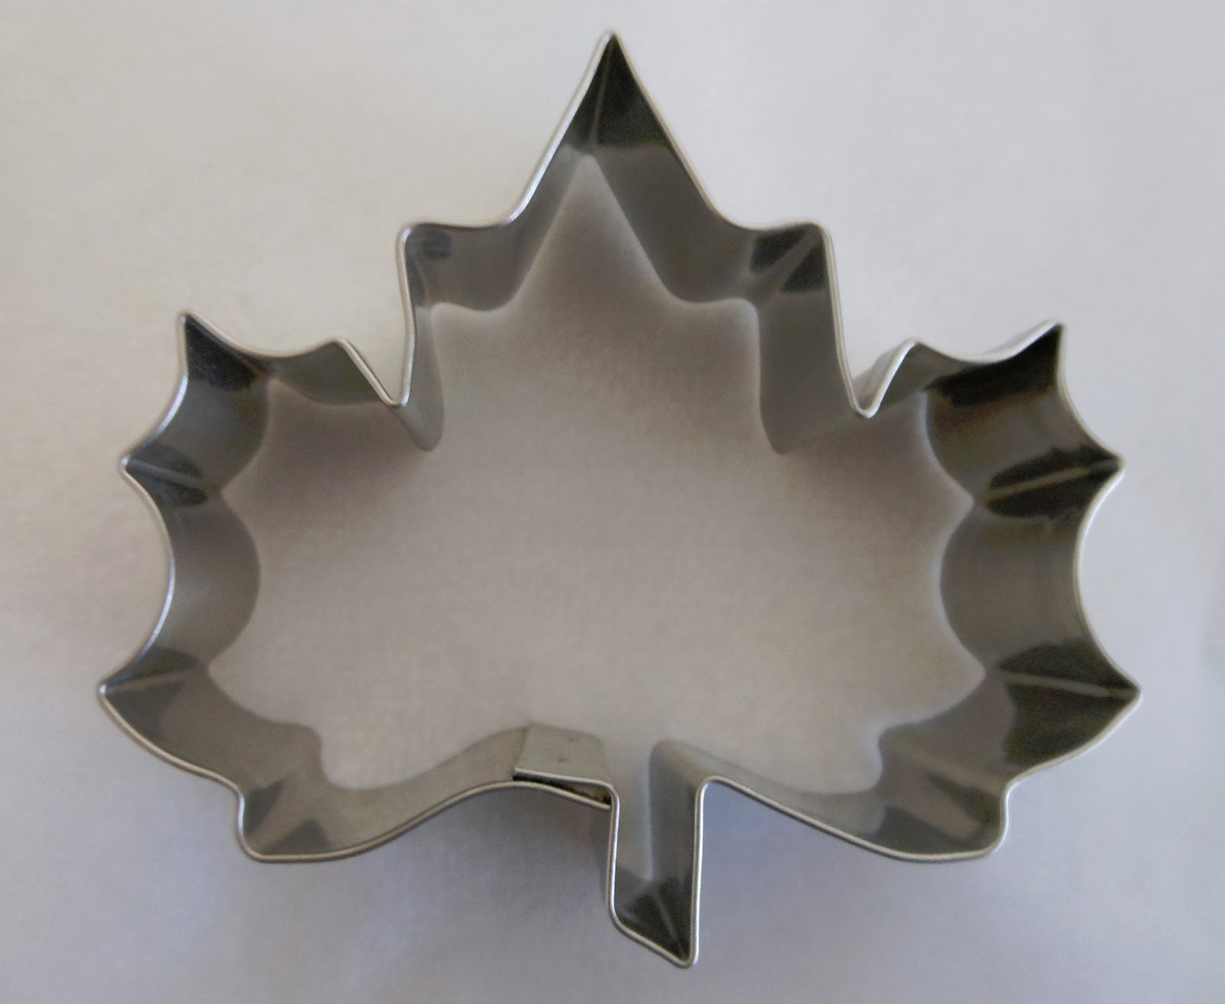
Maple Leafcutter Paraclemensia acerifoliella

Slide 36
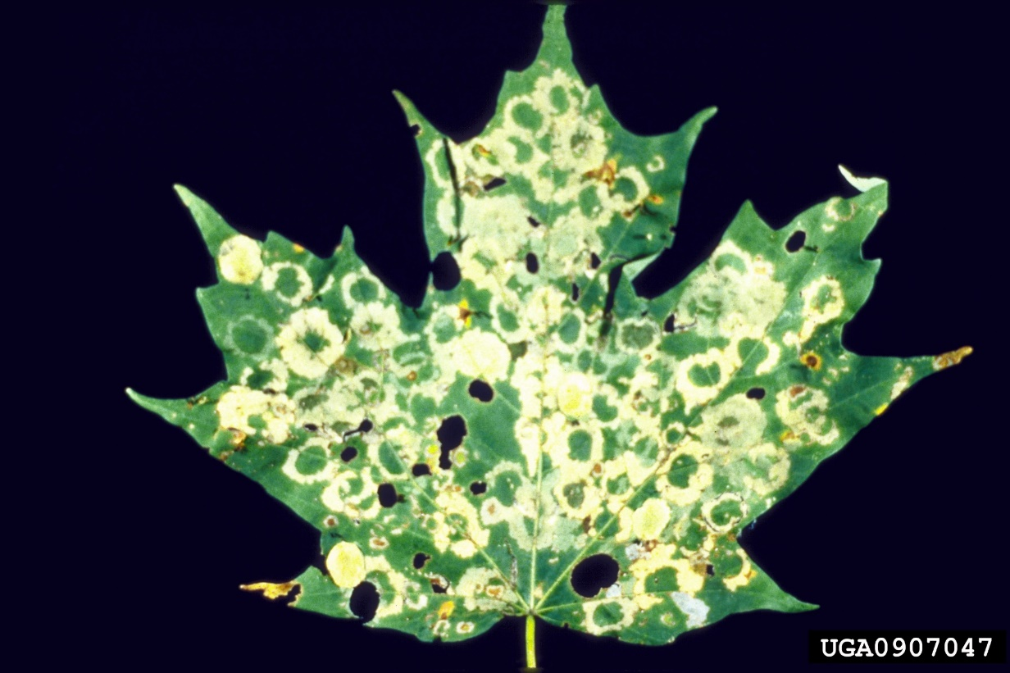
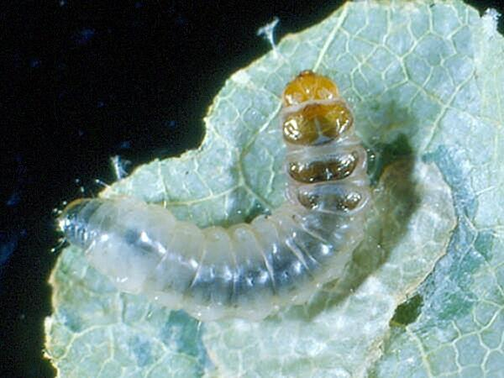
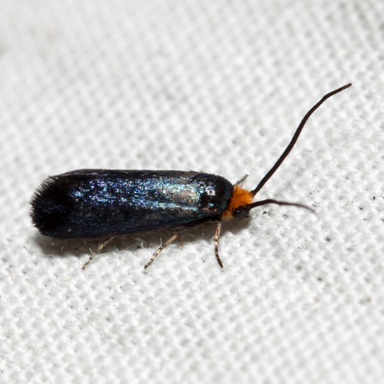
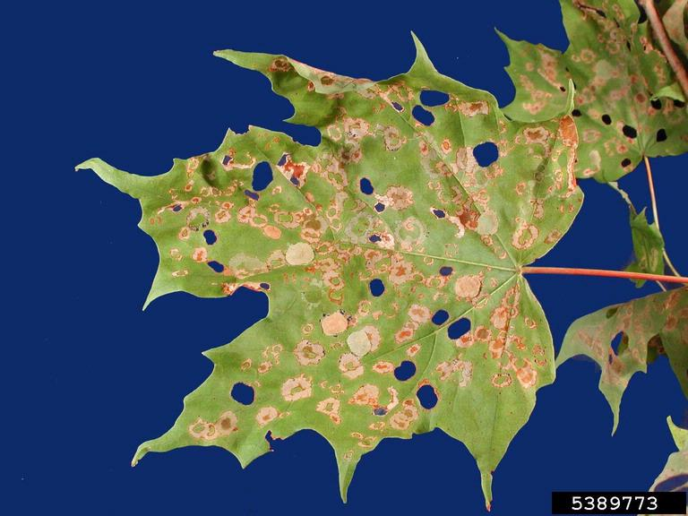
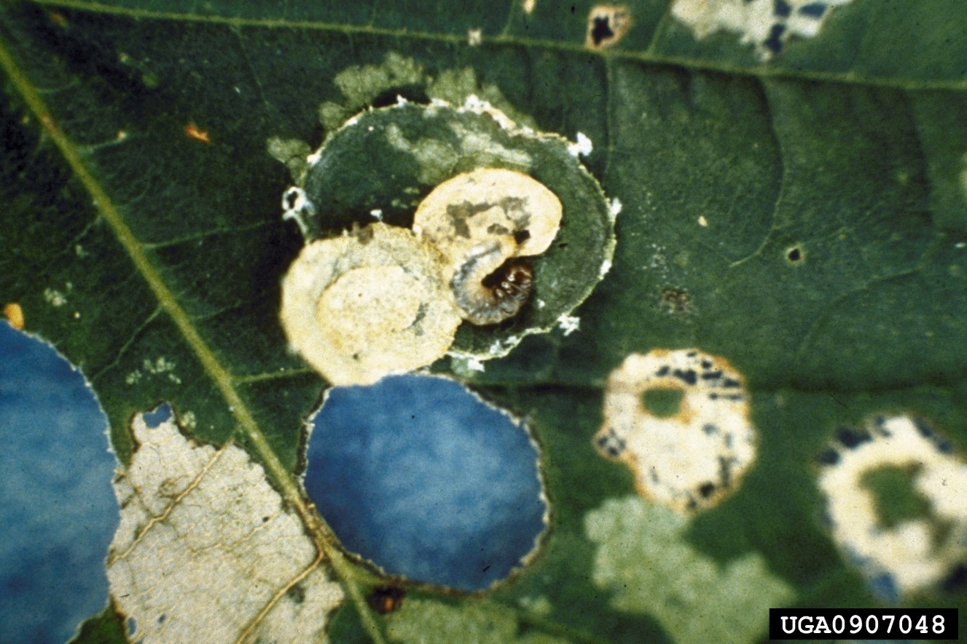

Slide 37
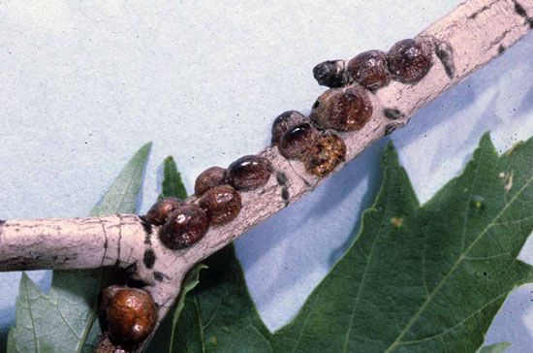
European Fruit Lecanium Scale

Slide 38
Excessive Tapping

Slide 39
Evaluating maple vitality

Slide 40
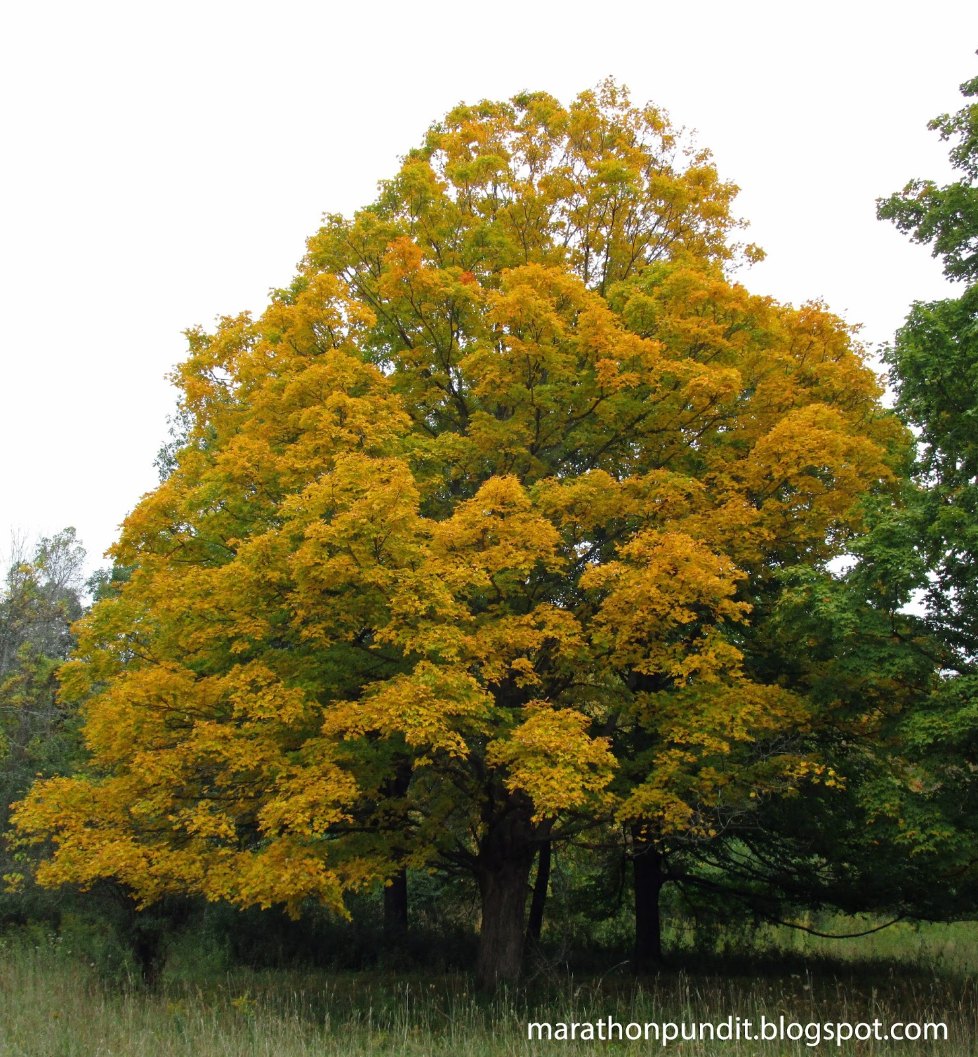
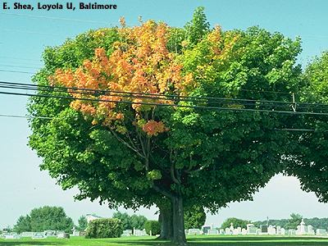
Early fall color, in part or whole crown.

Slide 41
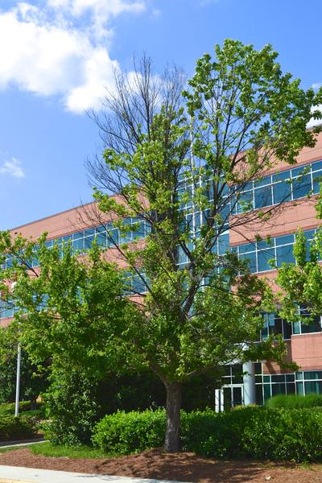
Crown thinning/ dieback

Slide 42
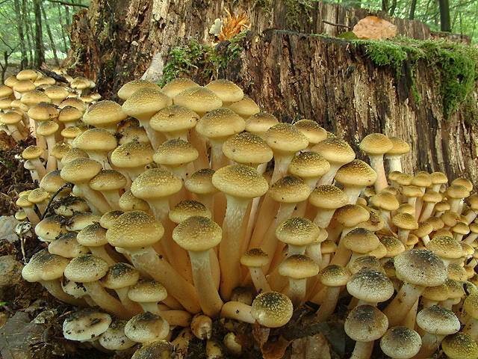
Yum…honey mushrooms

Slide 43
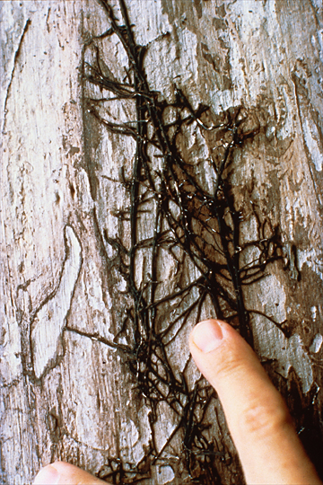
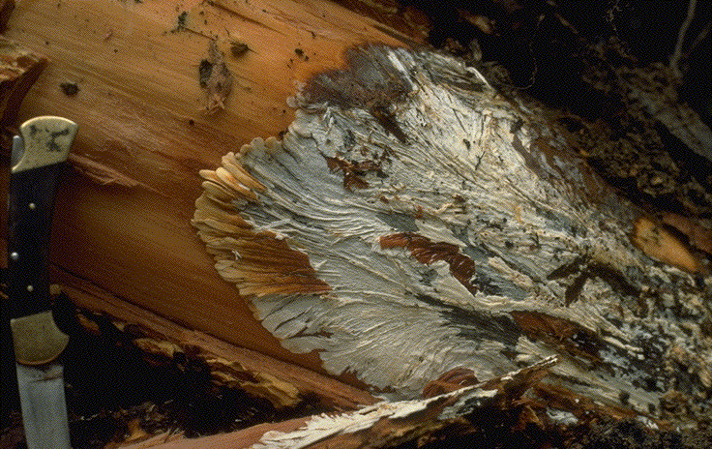
Armillaria mellea, a virulent pathogen

Slide 44
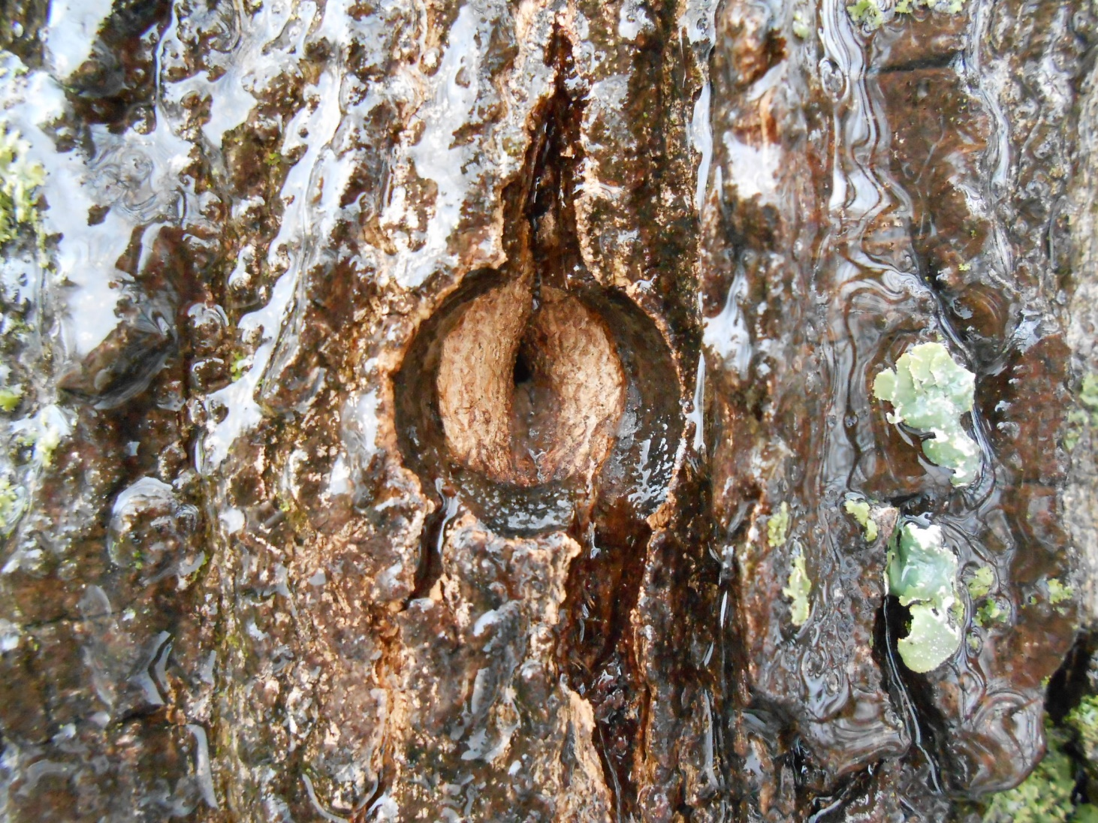
Wound response/ tap-hole closure: 1-2 years

Slide 45
Diameter growth

Slide 46
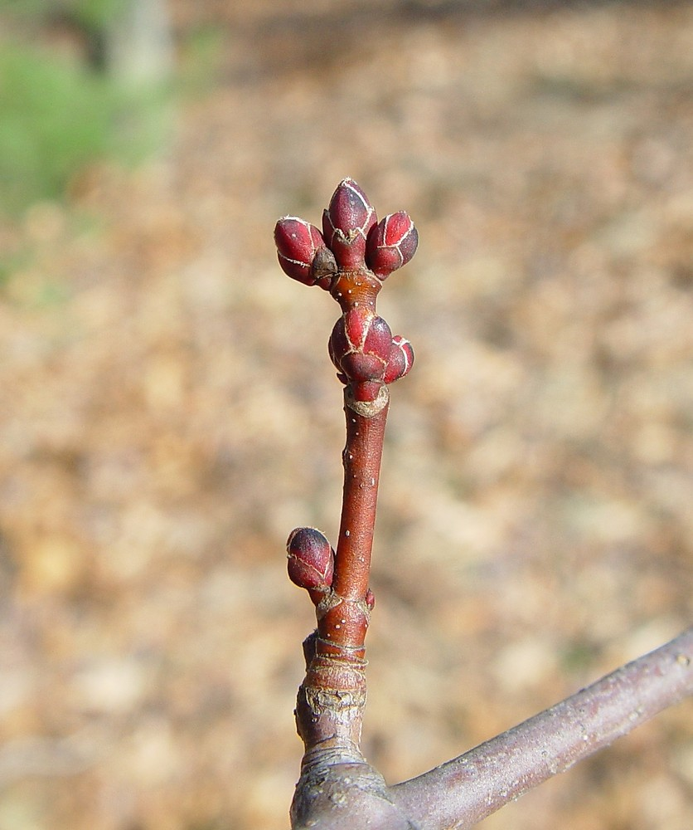
Twig elongation: reading between terminal-bud scars

Slide 47
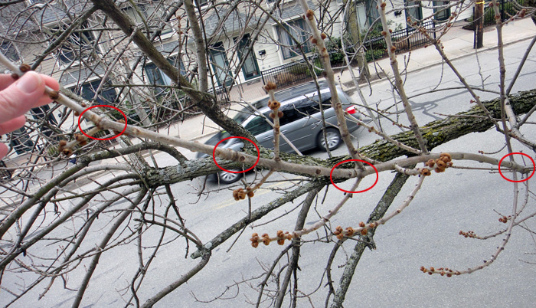

Slide 48
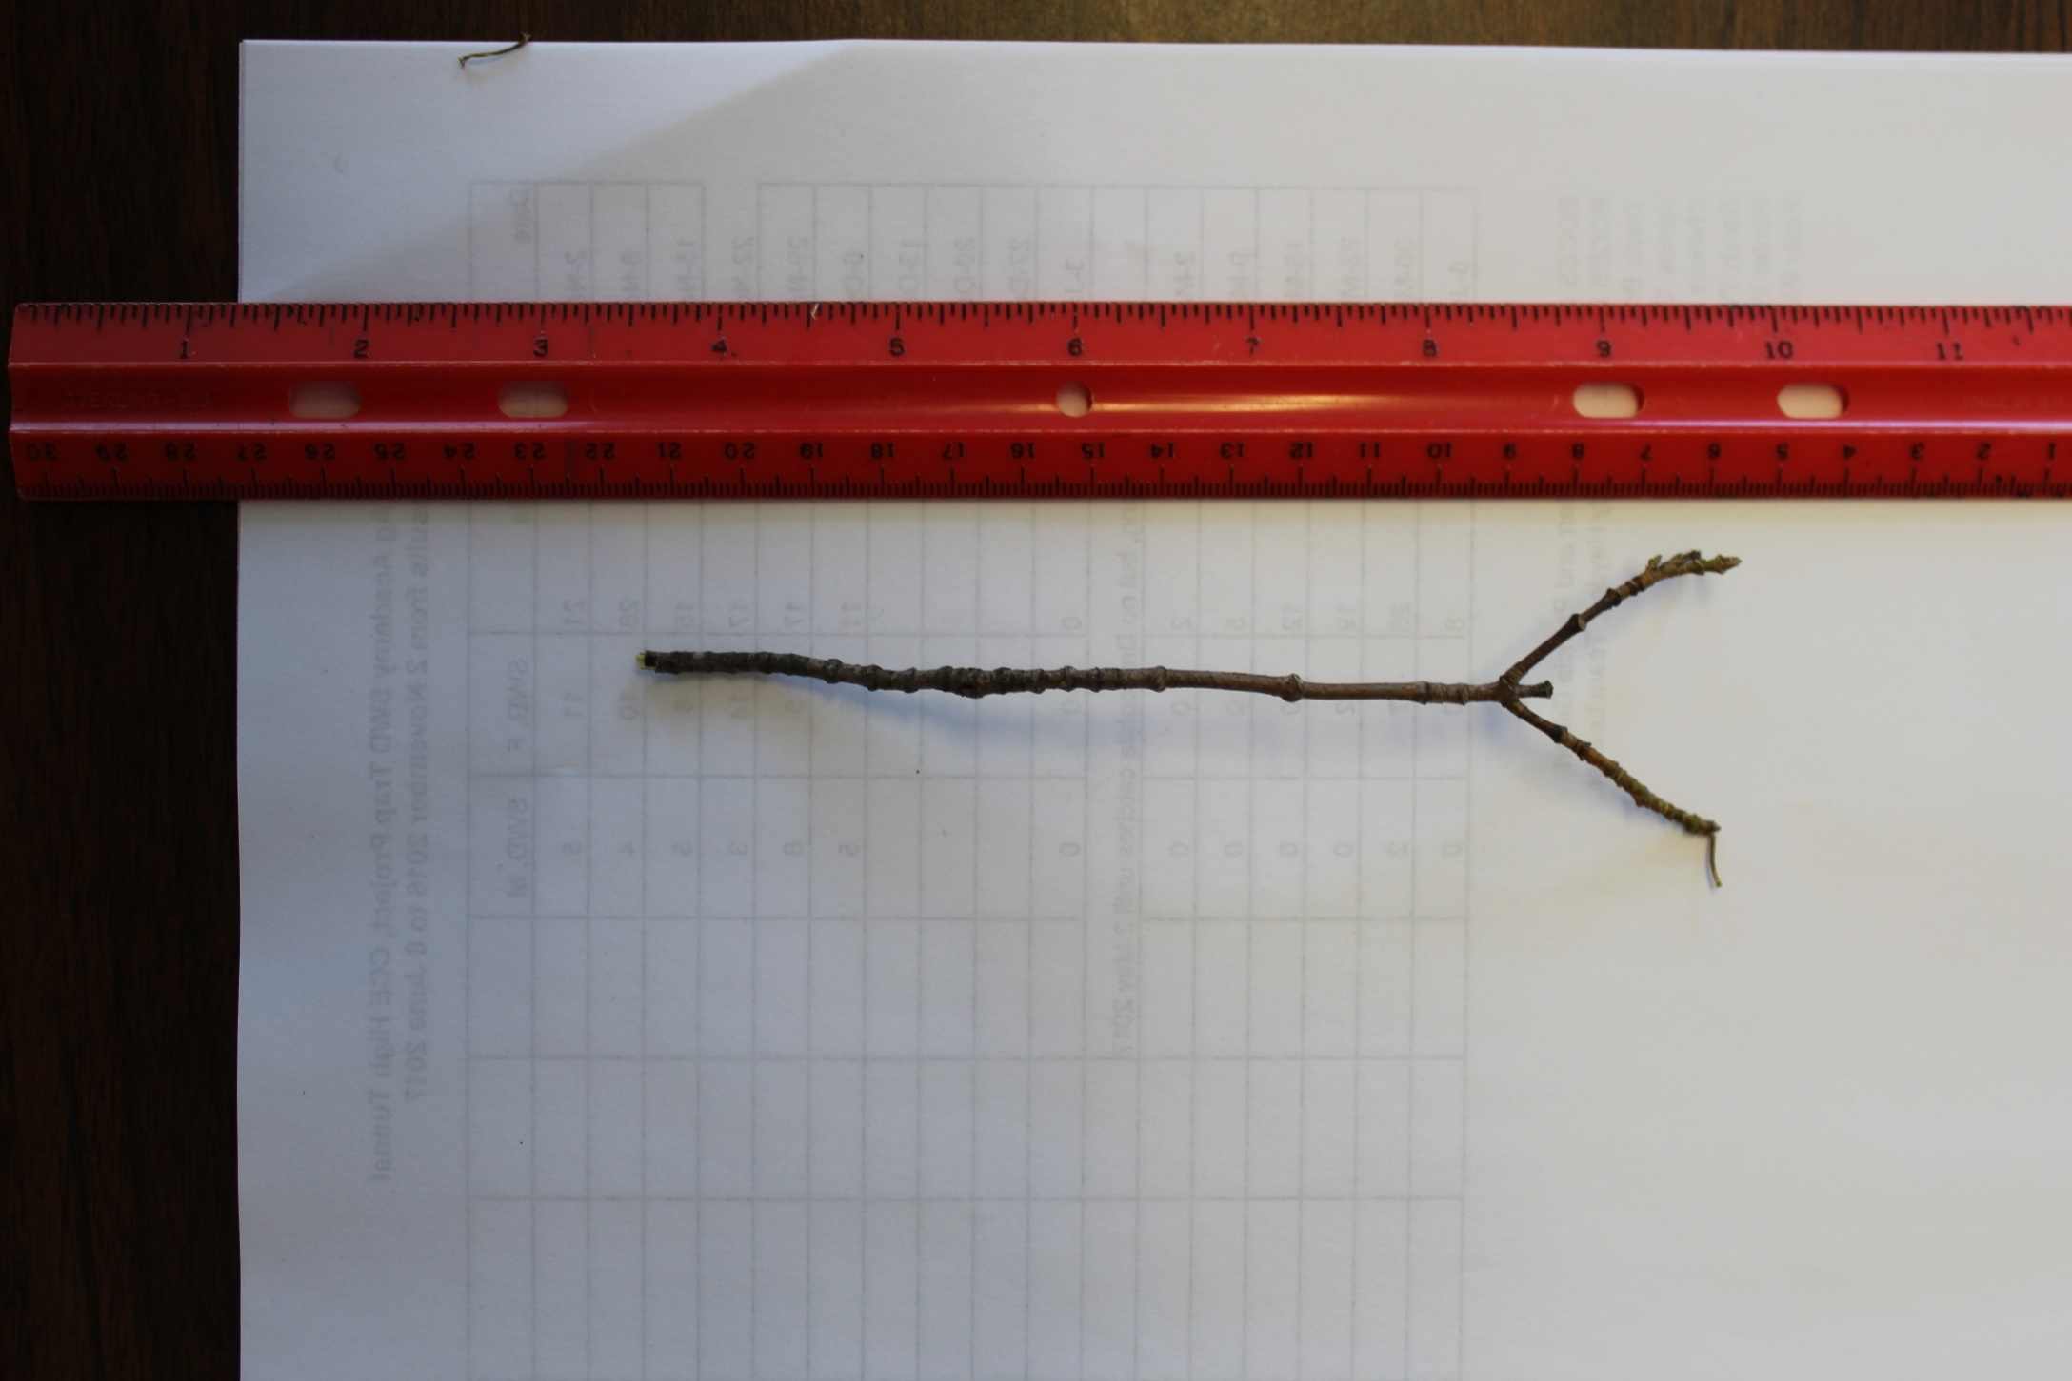
Poor

Slide 49
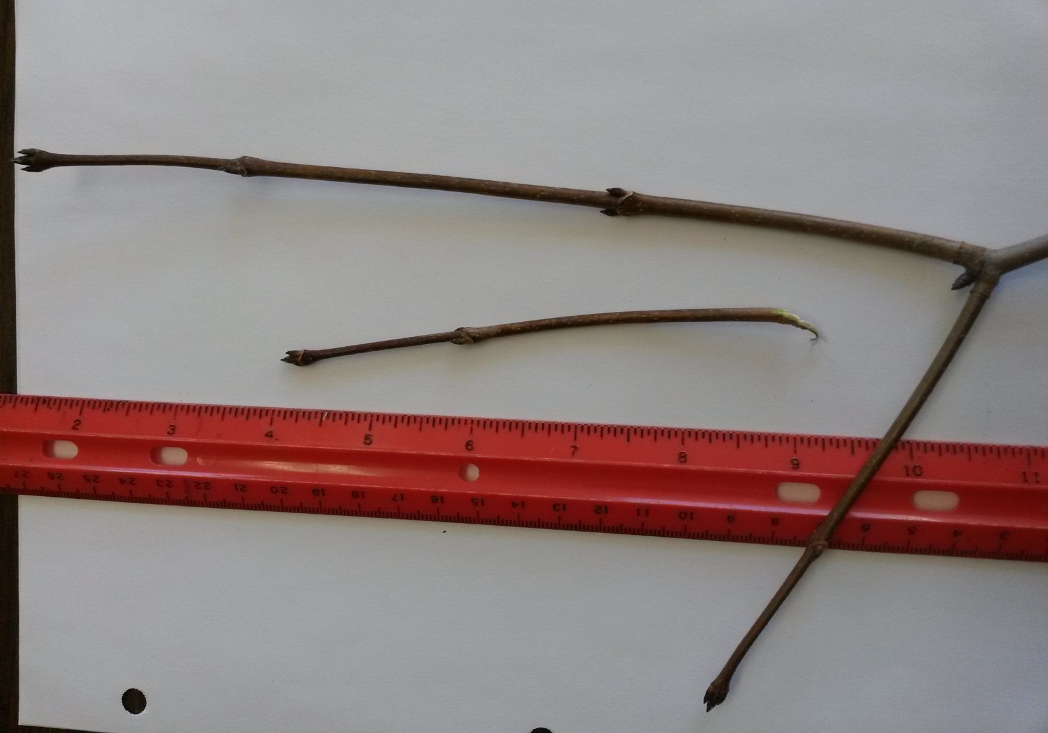
Good

Slide 50
Monitor potential stressors
Check for insect activity
Record rainfall
Check soil moisture maps
Supervise logging—no work in wet-soil conditions!!
Relocate “bad” skid or tractor trails
Evaluate crown closure and stocking level

Slide 51
Cull diseased trees “Diseased and damaged stems may spread inoculum, or may break and fall and damage other trees. Minimally they occupy growing space that doesn’t produce a high quality product.” –Peter Smallidge, Cornell State Extension Forester

Slide 52
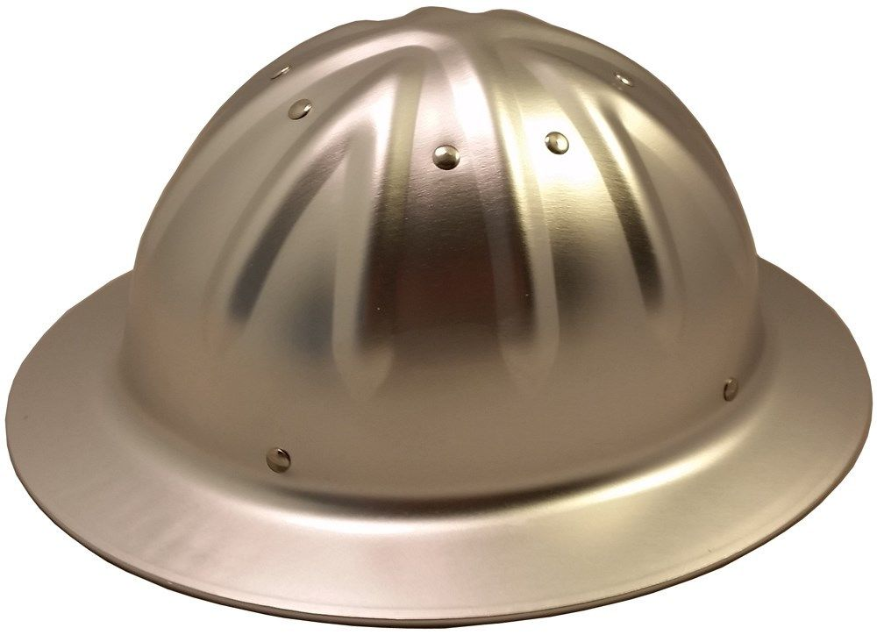
Other strategies:
Wear hardhats at all times.

