Slide 1
Successful Tree Establishment
Saint Regis Mohawk Forestry Resources Program
Kanien'kehá:ka Nation at Akwesasne
Paul Hetzler, ISA Certified Arborist
paul.j.hetzler@gmail.com
(613) 255-4966

Slide 2
Proper Tree Planting
There’s a lot more to it than just:

Slide 3
Green side up, guys…

Slide 4
Nope – try again…

Slide 5
Site Assessment
The key to successful tree ESTABLISHSMENT, i.e. the thing’s gonna live a long time.
It’s not but it’s important!

Slide 6
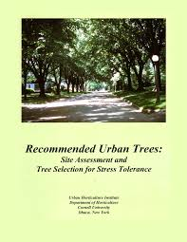
Cornell Urban Horticulture Institute; Tree Canada http://www.hort.cornell.edu/uhi/outreach/recurbtree/pdfs/~recurbtrees.pdf

Slide 7
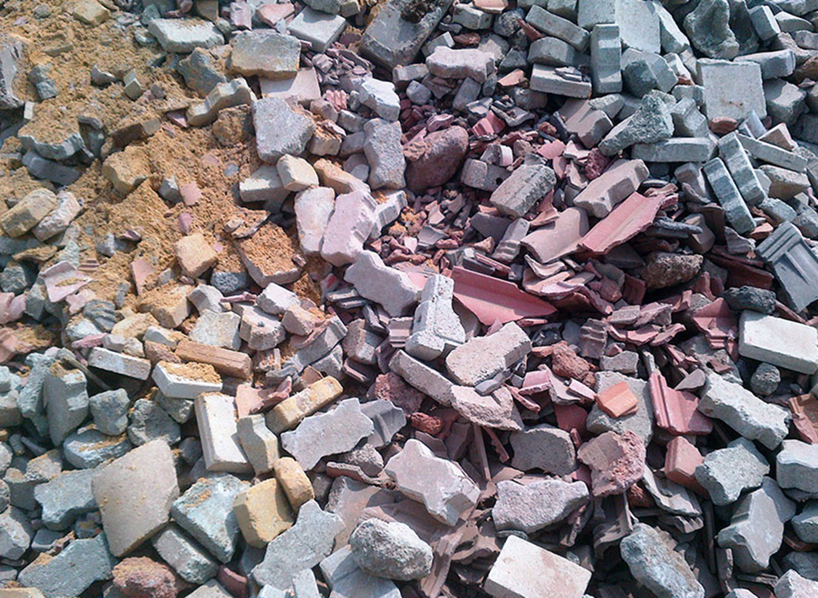
Soil Type
Coarse, Well-Drained vs. Fine

Slide 8
Drainage
Limits what species can be planted.
Planting high (berm planting) may be an option.
Sump system in planting hole also an option.

Slide 9
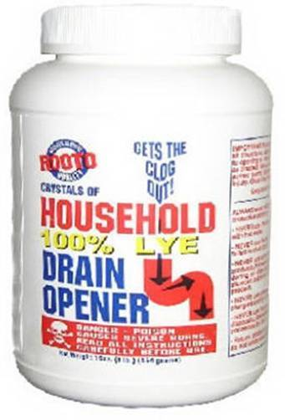
Acid vs. Alkaline: Soil pH Matters!
Determines which species will thrive, survive, or die.
Can be changed, but there are limits depending if limestone, concrete present.

Slide 10
Soil Compaction
How bad is it, and what if anything can you do beforehand?

Slide 11
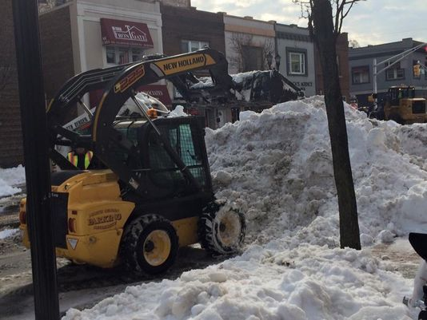
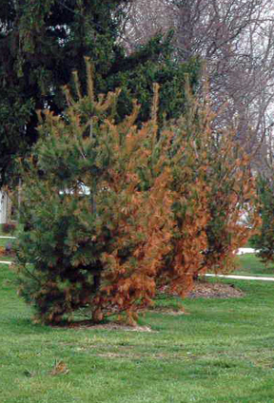
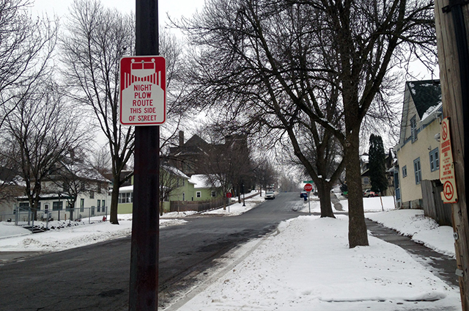
Deicing Salt

Slide 12
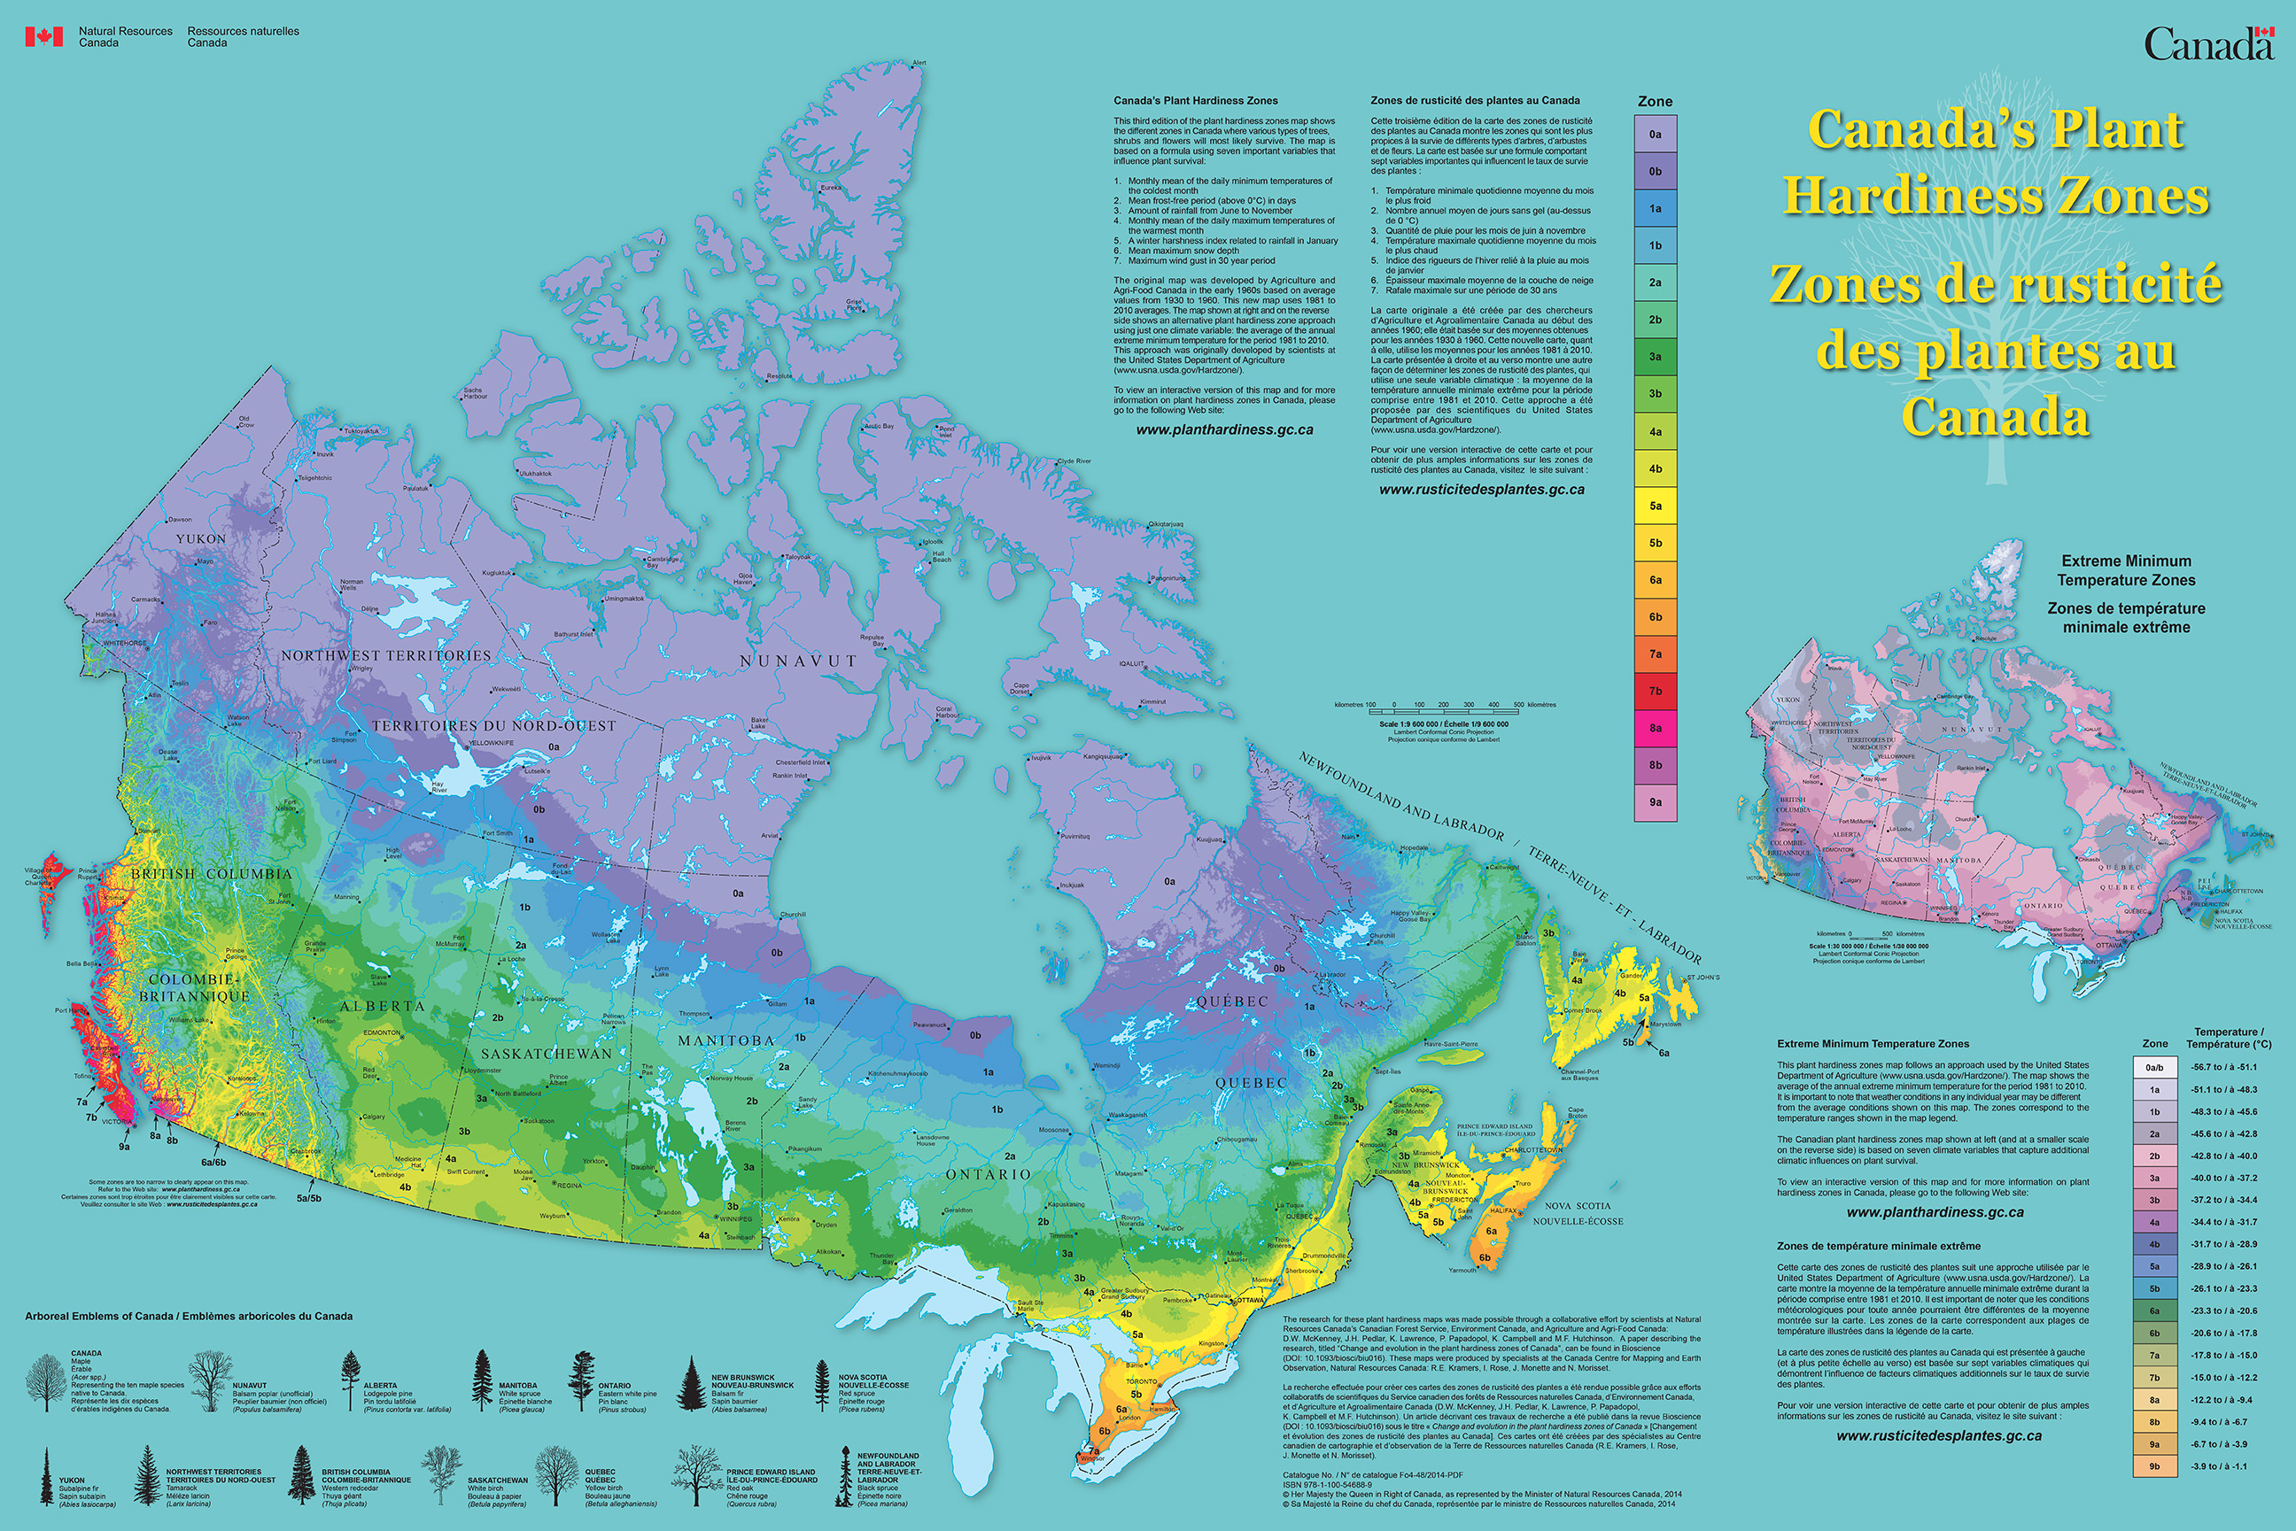
How COLD is the site?
Keep in mind the effect of winter wind.

Slide 13
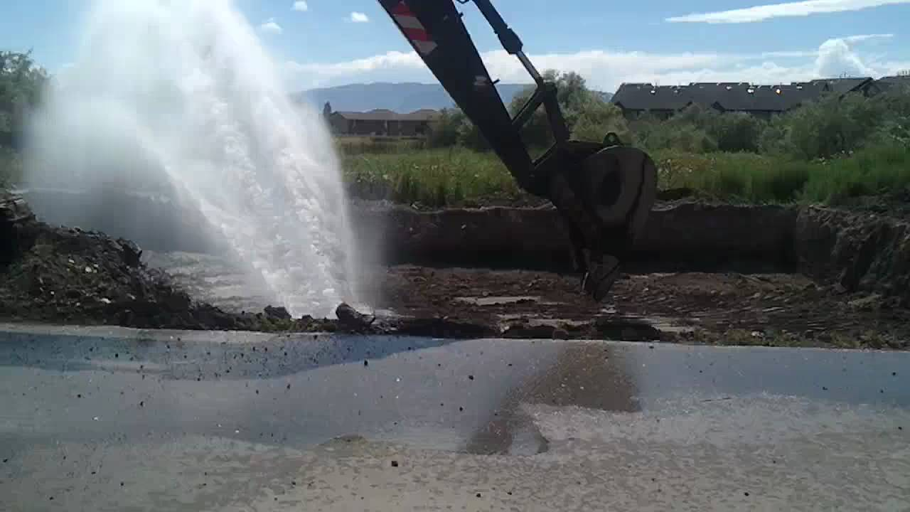
Dig Safe!

Slide 14
digsafecanada.ca

Slide 15
The Planting Hole
2x – 3x the width of the root system!
No deeper than the root system.

Slide 16
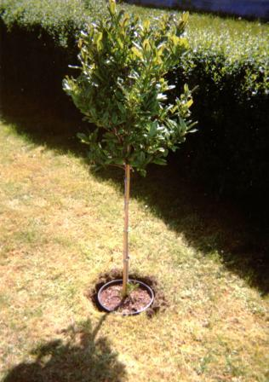
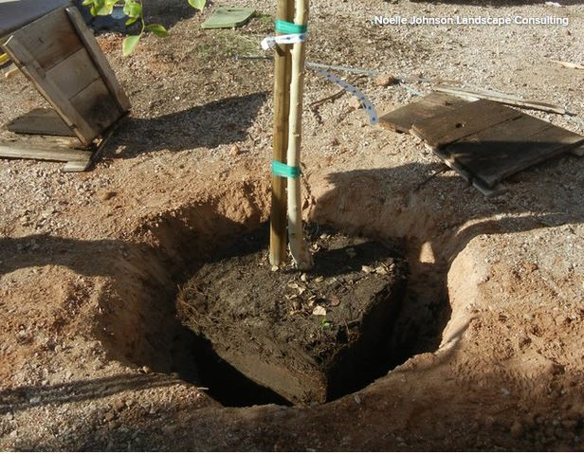
WRONG Bad contractor! No biscuit!

Slide 17
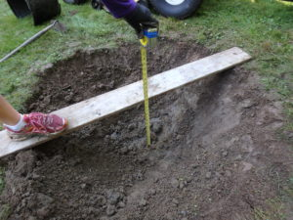
RIGHT!
GÉNIAL!

Slide 18
Radial Trenching: for Extreme Compaction and/ or Poorly Drained Sites
Trenches can be extended a lot more than this.

Slide 19
Why not plant deeper than the root ball?
Because…

Slide 20
Roots need this stuff:

Slide 21
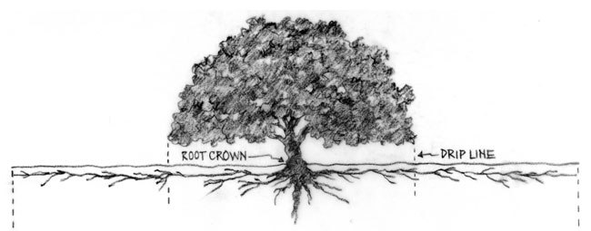
Tree Roots: 90% in top 25 cm; 98% in top 45 cm

Slide 24
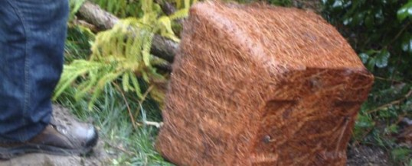
Container-Bound Roots

Slide 25
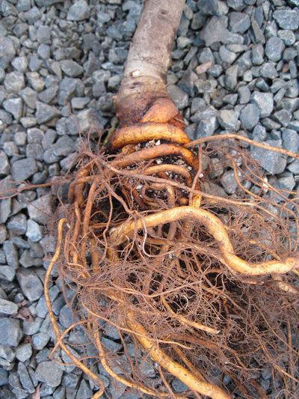
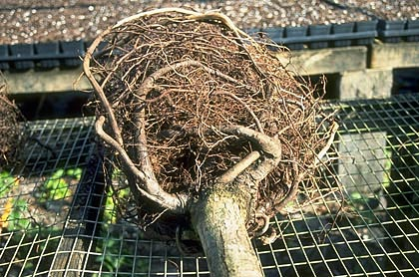
Lead to this:

Slide 26
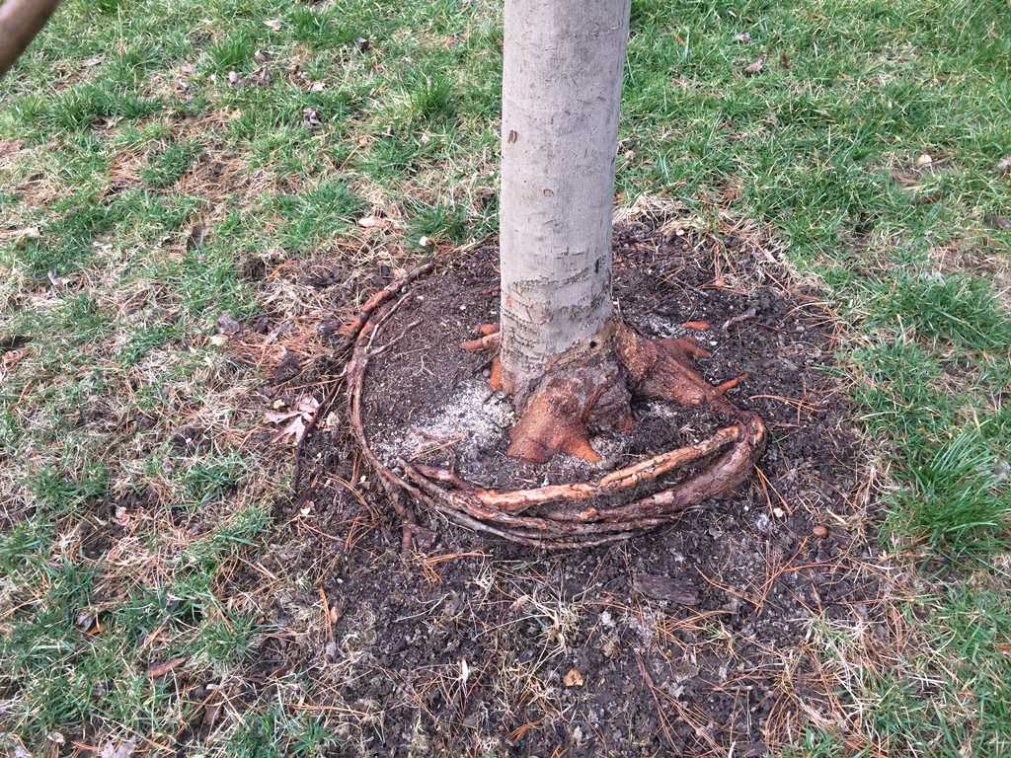
And this:
Girdling Roots

Slide 27
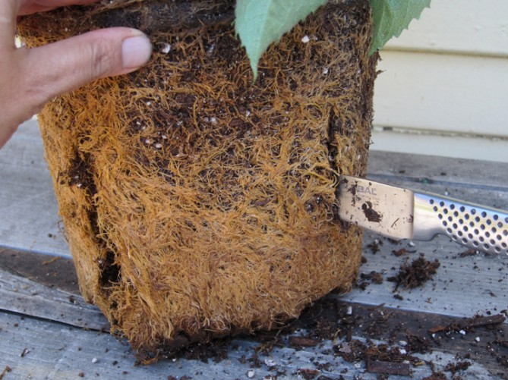
Before Planting!
Cut and Tease

Slide 28
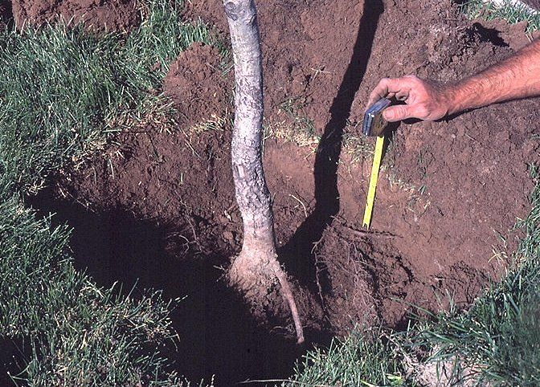
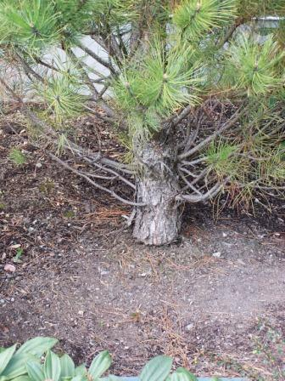
Planting depth is critical! These are too deep.

Slide 29
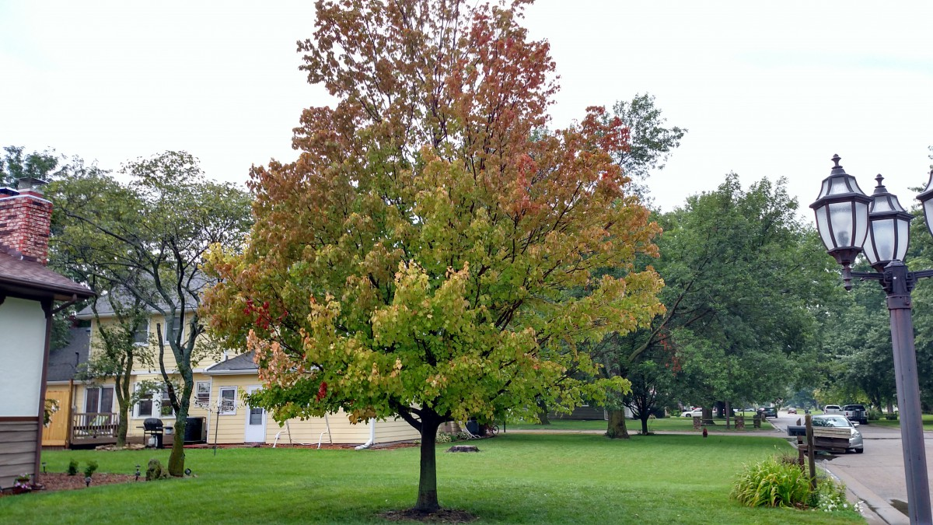
Girdling Roots/ Deep Planting lead to:
Poor Growth Rate Tip Dieback Early Fall Colour Sectional Decline
Premature Death

Slide 30
Root System Considerations:
For B&B, 80% - 85% of the of roots have been cut.
Circling roots often an issue for container-grown trees.

Slide 31
Bare-Root Trees: Almost 100% of roots intact! Requires hydrophilic polymer gel (aka snot…)

Slide 32
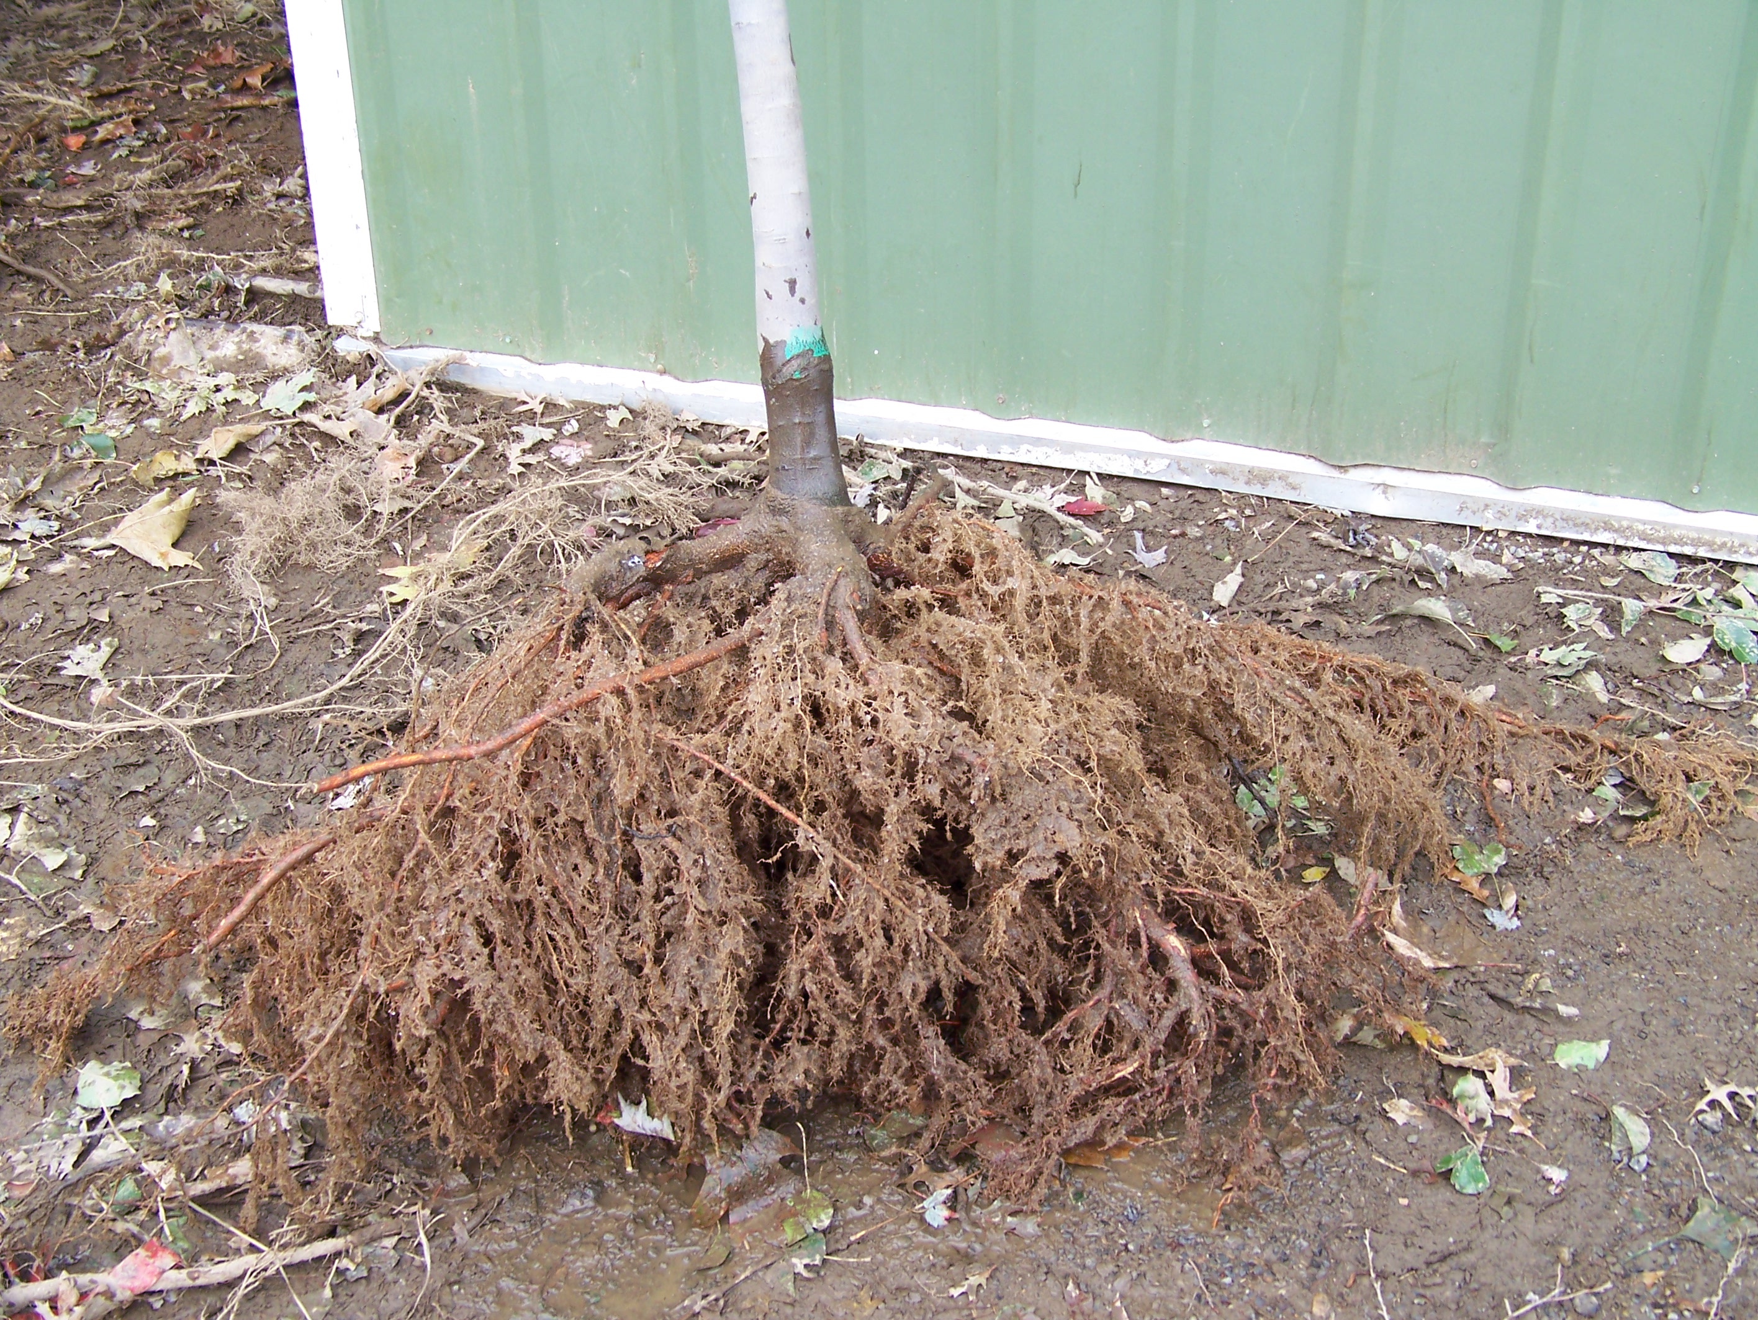
Plus, bare root is a lot cheaper to ship than B&B
Downsides:
Not all nurseries offer BR
Some spp. (oaks) are fussy
Timing is more critical

Slide 33
Mulching

Slide 34
No Volcanoes!

Slide 35
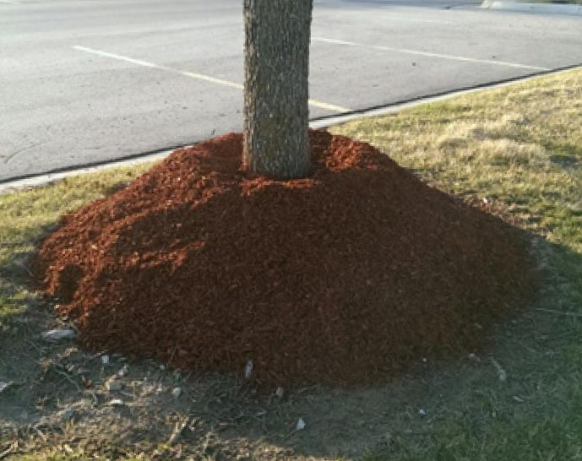
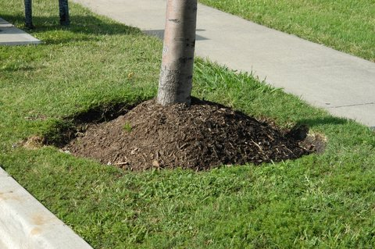
No! OMG, WTH?

Slide 36
YES!

Slide 37
Please do not stake…
Unless your tree is a vampire…

Slide 38
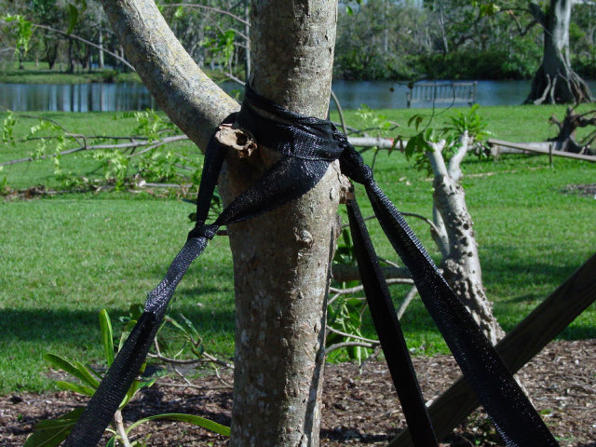
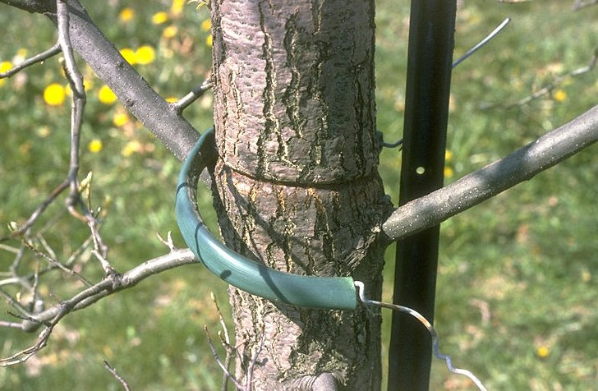
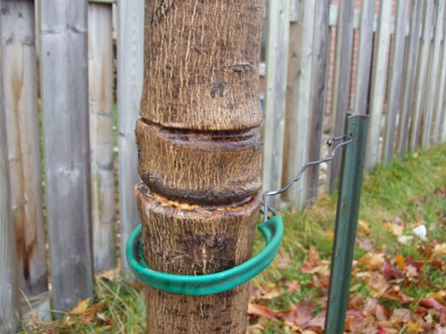

Slide 39
Hold the fertilizer
For at least one year.
After that, apply only if soil test indicates a need.
Good-quality (non-decorative) mulch is a source of slow-release nutrients.

Slide 40
Selection

Slide 41
Single Trunk

Slide 42
Good Form vs. Poor Form

Slide 43
Vertical Symmetry

Slide 44
Radial Symmetry

Slide 45
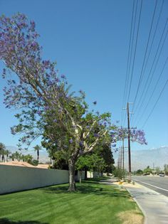
Right Tree, Right Place: How tall will it get? Where will its roots and branches go?

Slide 46
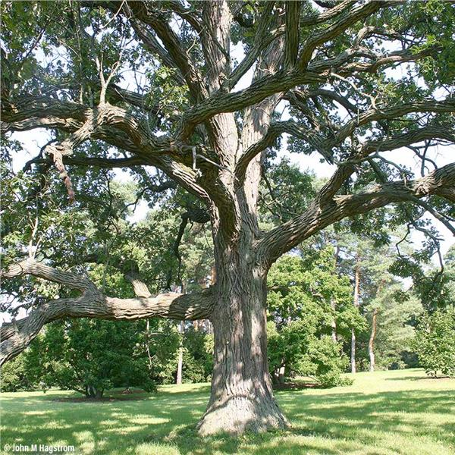
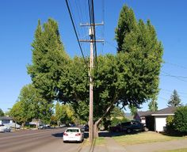
Think Ahead!
Planning will make the difference between a laughing-stock:
And a legacy:

Slide 47
Wait – What do you mean this is the wrong tree?
Paul Hetzler,
ISA Certified Arborist
paul.j.hetzler@gmail.com
(613) 255-4966

