Slide 1
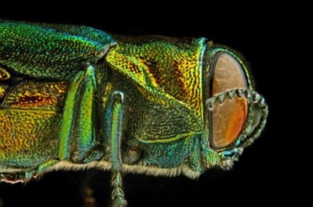
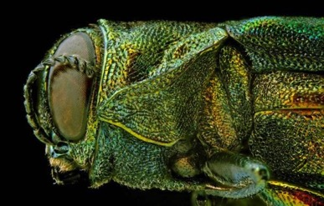




Biological Control of Emerald Ash Borer in New York
Kent Loeffler
Michael Jones & Dr. Melissa Fierke
SUNY ESF
Notes:
1

Slide 2
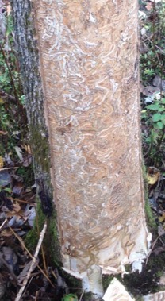
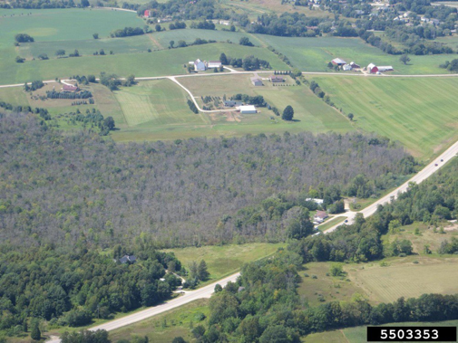
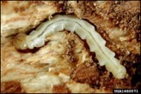
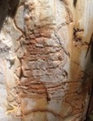
Impact of EAB
Native North American ash not resistant
Lack of native predators
Larval feeding girdles & disrupts transportation of nutrients
10’s of millions of trees killed

Slide 3
Current Distribution of EAB

Slide 4
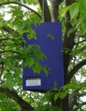
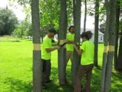
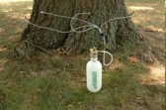
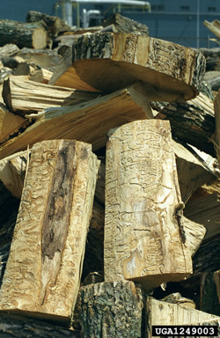
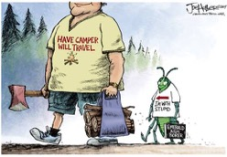
EAB Management
  Detection
  Delimitation
  Slow Ash Mortality
      Mechanical
      Insecticides
          TREE-age
      Biocontrol
          Parasitoids
  Education
        Firewood
  Legal
        Quarantines

Slide 5
EAB Biological Control Program
Introduce predators from native range of a pest
  Long range and sustainable
Four specialized wasps (parasitoids) introduced to North America
Notes:
SA from Tianjin- southern China, SG- Russian Far East, TP- Jilin, China

Slide 6
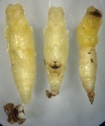
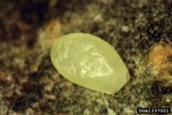
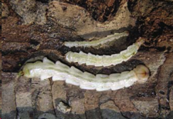
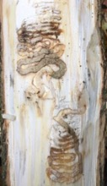
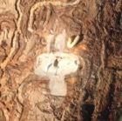
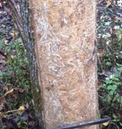
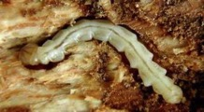
EAB Biology
SUMMER
SPRING
WINTER
Notes:
Adults 7.5 - 15 mm long.

Slide 7
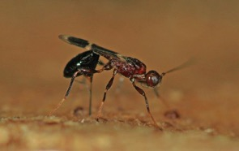
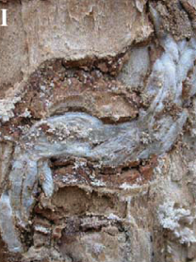
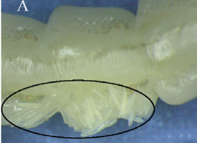

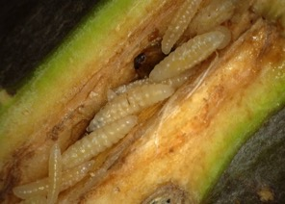
Life Cycle of Larval Parasitoids
Adult
Eggs
EAB larvae
Cocoons
Larvae
Photo credits: Zhong-Qi Yang
Notes:
Gregarious and short development time – multiple generations each season

Slide 8
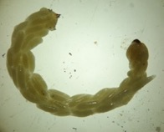
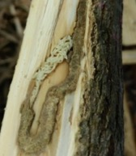
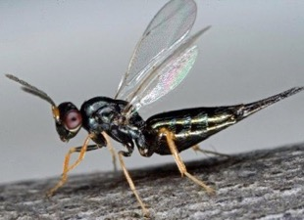
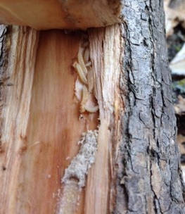
EAB Biocontrol Program
Specific to EAB
Release approved 2007 (24/31 states)
T. planipennisi establishing
O. agrili establishing
S. agrili more suited to southern climates
Climate matching suggests S. galinae better adapted to northern climates

Slide 9
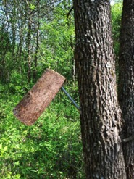
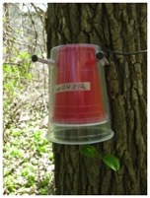
Releasing Parasitoids in NY
Release parasitoids in heavily infested area to help them establish
  Released in most large infestation in NY

Slide 10
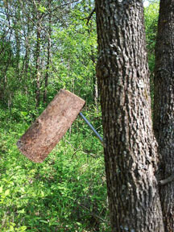

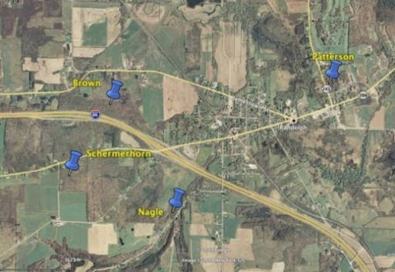
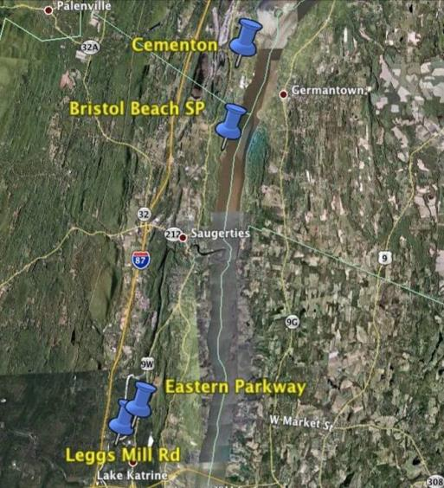
Parasitoid Releases
Randolph & Hudson River Valley
Quantify if parasitoid release slows ash mortality

Slide 11
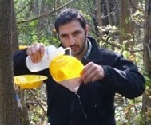
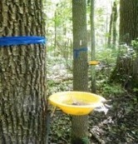
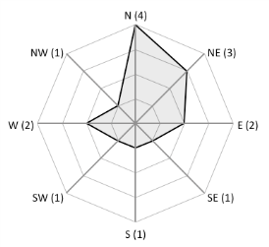
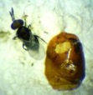
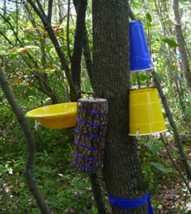
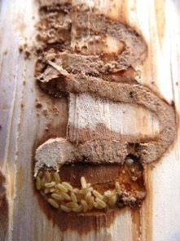
  EAB parasitoid recovery
    How well can we recover parasitoids once released?
    How far do they move and in what directions?
Notes:
Can we even detect their establishment? How good are our detection tools

Slide 12
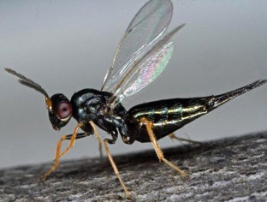
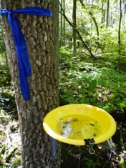
Parasitoid Dispersal
How well does T. planipennisi track and follow the movement of EAB?
Genesee Valley Greenway – linear corridor of infested ash
Trap along the corridor and monitor EAB and parasitoid movement

Slide 13
Parasitoid Dispersal

Slide 17
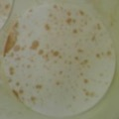
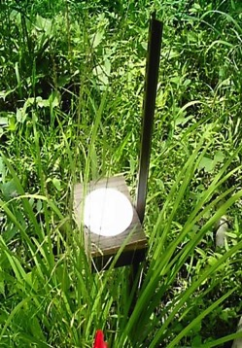
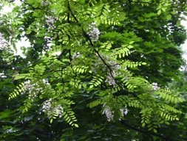
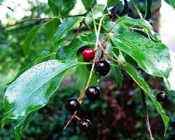
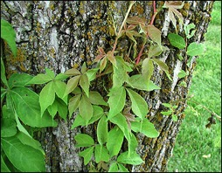
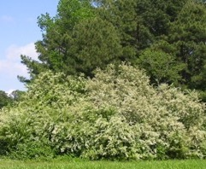
What do the adult parasitoids feed on?
  Flowers
  Honeydew
  Extrafloral nectaries
Notes:
Adults don’t feed on EAB larvae, but require sugar water. Will parasitoids establish better when there are plentiful food sources

Slide 18
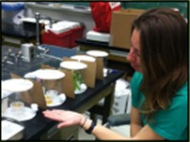
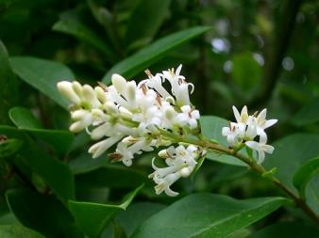
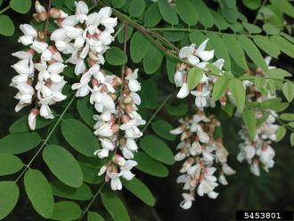
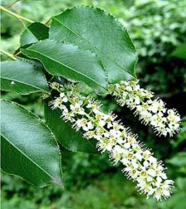
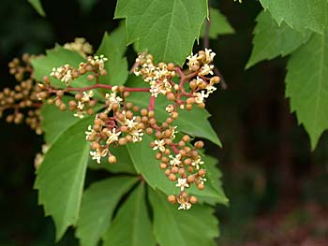
Food Preferences
    Attraction to potential nutrient resources

Slide 19





Parasitoid Phenology
  Does the phenology of EAB emergence match with parasitoids?
  How well do they overwinter in the northeast?
Notes:
Phenology – study of an organisms life cycle as it is influenced by environmental factors (temps, light, etc)

Slide 20



Parasitoid Phenology
Open-air Insectary
Growth Chambers
Caged Trees

Slide 21



Parasitoid Phenology
EAB Phenology
  Optimal host: 3rd/4th larvae
72 trees
>5,000 EAB

Slide 22



Overwintering EAB Mortality

Slide 23

Parasitoid Phenology

Slide 24




Results – Overwintering
Parasitoids released late fall
Only S. galinae and T. planipennisi adults emerge following spring
S. galinae overwintering cocoons
Summer Cocoons
Winter Cocoons
Notes:
Appears that S. galinae eggs and larvae oviposited after Aug can reach diapause

Slide 25

Biological Control and Insecticide Use
Notes:
Can it work, is it a viable option for EAB management

Slide 26











Research Technicians
  Brad
  Jared
  Ian
  Ryan
  Terrance
  Emily
  Richard
Research Support Specialists
  Mike Parisio
  Trupti Indurkar
  Ben
  James
  Devin
  Odin
  Hope
  Lorenzo
  Emma
  Brandon
  Elise
  Odin
  Igor
  Raphael
  Dan

Slide 27


















Collaborators, Past Technicians & Funding
  Mark Whitmore, John Vandenberg, Jerry Carlson, Juli Gould
  John Welsh, Katie Walters, DEC (Jess Cancellerie, Rob Cole, Maria Moskalee, Josh Payette, Tucker Money), A&M Ethan Angell, and Fumi Afelumo
USDA McIntire-Stennis

Slide 28

QUESTIONS?

